Slide 1
The Influence of Experimenter Status on Suggestibility
Lindsay Marsh
Eric Sharp
Hanover College

Slide 2
Eyewitness Testimonies in Court
In the U.S. court system, eyewitness testimonies are often regarded as reliable evidence
Deposition phase, followed by trial phase
Lawyers for both sides are present at both phases
Jury is only present for trial phase
Leading questions during the deposition phase can manipulate testimonies given in trial phase

Slide 3
What is Suggestibility?
Testimonies can be altered because of suggestibility
Suggestibility is being influenced by or accepting the statements of others
One way to measure suggestibility is by the presence of false memories

Slide 4
False Memories
False memories occur when people recall something that was not presented to them
Manipulation of wording in questioning can elicit false memories
Car crash study (Loftus & Palmer, 1974)
About how fast were the cars going when they _____ each other?

Slide 5
Relationship between Experimenter Status and Suggestibility
When children are questioned by other children, their suggestibility decreases (Ceci, Toglia, & Ross, 1987)
Perceived authority influencing recall of memories (Paddock & Terranova, 2001)
Expert vs. Non-expert conditions

Slide 6
Suggestibility and Personality Variables
More compliant individuals are vulnerable to leading questions (Richardson & Kelly, 2004)
Emotional children were more suggestible (Chae & Ceci, 2005)
Big Five Factors of Personality- Agreeableness and Neuroticism

Slide 7
Suggestibility in Eyewitness Testimonies
Changes can occur from deposition phase to trial phase in eyewitness testimonies
These changes are influenced by:
Leading questions vs. neutral questions
Status of interviewer
Personality traits of interviewee

Slide 8
Our Hypotheses
Participants are more suggestible when asked leading questions by the experimenter that has high status
Participants with high scores of Agreeableness and Neuroticism have overall higher suggestibility

Slide 9
Method: Participants
All participants (N = 42) were undergraduate students at Hanover College
71.4% female (n = 30), 28.6% male (n = 12)
Average age was 19.6 years old, the ages ranged from 18 to 22 years old
90.5% were Caucasian (n = 38), 2 African American, 1 Asian, and 1 multi-racial

Slide 10
Method: Creating Groups
We had separate sign up sheets for each experimenter
Randomly assigned to question type
Student Experimenter Neutral Questions 11 participants | Student Experimenter Leading Questions 14 participants
Professor Experimenter Neutral Questions 6 participants | Professor Experimenter Leading Questions 11 participants

Slide 11
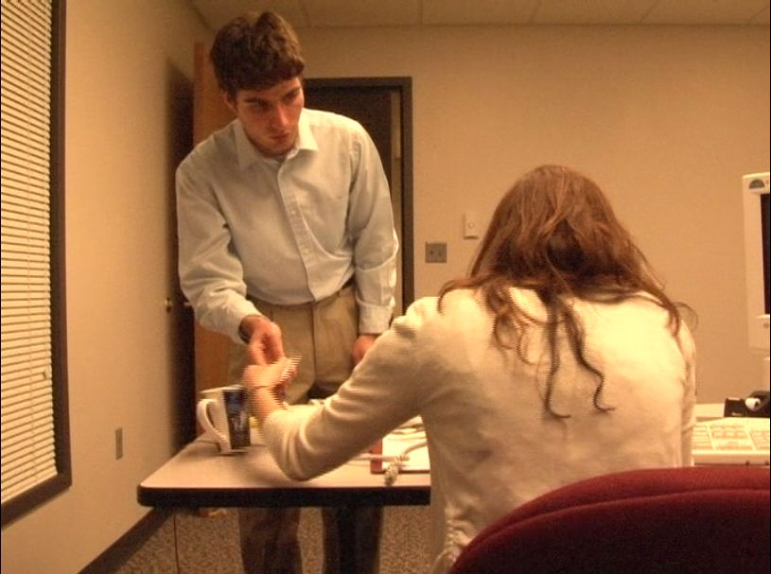
Method: Video
To stage an event that can be reported later, we created a 60 second video clip.

Slide 12
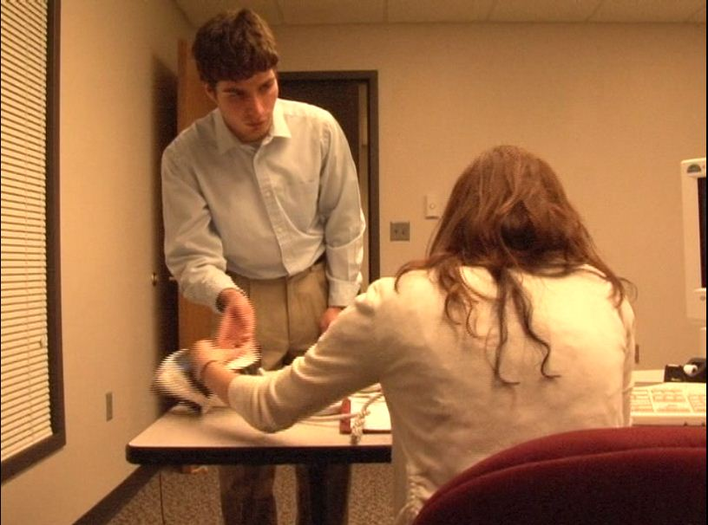
Method: Video
In the video, a coffee mug gets accidently knocked off of the desk.

Slide 13
Method: Retrieval Phase I
Experimenter read open-ended questions
Leading vs. Neutral
Question repeated twice
Participants wrote down responses
Simulated deposition phase

Slide 14
Method: Retrieval Phase I
Example questions
Neutral questions
How did the man react when the coffee mug landed on the floor?
Leading questions
How did the man react when the coffee mug smashed onto the floor?

Slide 15
Intervening task
Participants watched two episodes of the Nickelodeon cartoon Doug
Lasted approximately 23 minutes
Simulated time between deposition and trial
Mentally engage in something other than video clip

Slide 16
Retrieval Phase II
Participants asked to fill out recall worksheet
Open-ended neutral questions answered on an 8-point Likert scale
“How would you assess the state of the coffee mug at the end of the video clip?”
Simulated trial phase

Slide 17
Method: Scales
Big Five personality assessment (focus on Agreeableness and Neuroticism)
Openness to Experience
Conscientiousness
Extraversion
Agreeableness
Neuroticism
Demographic Questionnaire
Debriefing

Slide 18
Marginally Significant Main Effect for Question Type, F(1, 45) = 3.01, p = 0.09

Slide 19
Significant Main Effect for Status, F(1,45) = 4.34, p = 0.04

Slide 20
2 x 2 between-subjects ANOVA No significant interaction.

Slide 21
Significant Main Effect for Openness to Experience, F(1,45) = 5.99, p = 0.02

Slide 22
Discussion: Question Type
We found a main effect for question type
Leading question condition produced more perceived damage for mug than neutral question condition
Consistent with Loftus and Palmer (1974) car crash study

Slide 23
Discussion: Status
We found a main effect for status
High status condition produced more perceived damage for mug than low status condition
Why main effect, but no interaction?
Higher status could imply greater perceived severity of event

Slide 24
Discussion: Openness to Experience
We found a main effect for Openness to Experience
Higher scores of Openness to Experience produced higher perceived damage to mug
Why main effect, but no interaction?
On our assessment, Openness to Experience encompasses imaginative qualities
Higher imaginative traits may produce more embellished/damaged memory of mug

Slide 25
Personality Variables
Openness to Experience | Conscien-tiousness | Extraversion | Agreeable-ness | Neuroticism
Imaginative | Organized | Talkative | Sympathetic | Tense
Intelligent | Thorough | Assertive | Kind | Anxious
Original | Efficient | Active | Soft-hearted | Nervous
Insightful | Responsible | Energetic | Warm | Worrying
Clever | Practical | Outgoing | Generous | Self-pitying

Slide 26
Discussion: Implications of Findings
Small changes in question type (‘smashed’ vs. ‘landed’) can elicit false memories
Status facilitates higher levels of suggestibility
Age
Clothing/appearance
Expertise
Gender
Occupation
Perceived intelligence/authority

Slide 27
Limitations
Time between retrieval phase 1 & 2
Possible variables within status:
Age
Gender
Occupation
Eyes that pierce through your soul
Small, homogeneous sample

Slide 28
Future Research
Investigate influence of time
Our study used a delay period of about 25 minutes
Other studies of this type have used delay periods ranging from days to weeks
Explore variables of status as related to suggestibility

