Slide 1
The Relationship Between Implicit and Explicit Gender
Jacob Cooper and Karin Schubert
Hanover College
2009

Slide 2
Introduction
Gender Schema Theory (Bem, 1981): People internalize conceptions of gender as a means of organizing, processing, and interpreting information about their world or their selves.
Feminine: having qualities or attributes which are usually associated with females in this culture
Masculine: having qualities or attributes which are usually associated with males in this culture
Notes:
JACOB
When one meets a new person, likely one of the first things he or she will notice about the person is their gender. This is not surprising, since distinctions between genders permeate practically every aspect of every human society. People use gender as a category to define anything from inanimate objects to their conception of their self. Though individual expectations and attitudes toward each gender vary across cultures, the primary distinction remains.
Gender schema theory helps explain the process by which people internalize conceptions of gender as a means of organizing, processing, and interpreting information about their world or their selves. In essence, a person is gender schematic to the degree that "their self-concepts and behaviors are organized on the basis of gender" (Bem, 1981; 89).
Gender schemata are based on cultural constructs of femininity and masculinity. For the purposes of this study, femininity is defined as having qualities or attributes which are usually associated with females, while masculinity is defined as having qualities or attributes which are usually associated with males.

Slide 3
Introduction
Tested differences between men and women (Lippa, 2006)
Behavior problems
Childhood behaviors
Sexual orientation
Sex drive
Social dominance orientation
Tendency of social-emotional vs. task-oriented behaviors
Occupational preference (Lippa, 1998)
Women prefer people-oriented occupations, whereas men prefer thing-oriented occupations (p < .0001).
How do researchers test for these differences?
Notes:
KARIN—say we will come back to people-things later
There has been literal volumes of research done to determine the differences between women and men. A polarization is present in much of this research; some of it seems to emphasize differences between women and men, while some of it seems to minimize these differences. Regardless of one's perspective on gender, enough research exists that it would be impossible not to acknowledge some of these reported differences.
In a review article, Richard Lippa lists some of the most pronounced differences between women and men, including incidence and prevalence of many behavior problems, several childhood behaviors, sexual orientation, sex drive, social dominance orientation, and tendency of social-emotional behaviors or task-oriented behaviors.
Occupational preference has proved to be one of the most pronounced differences between women and men. When testing participants' preferences for a list of 131 occupations that were categorized as people-oriented or thing-oriented, Lippa found that the relationship between gender and the preference for people or thing oriented occupations was highly significant.

Slide 4
Explicit Measurement
Surveys or questionnaires
Rely on a participant's conscious, "explicit" attitudes and beliefs
Most common way of measuring gender schema
Limitations
Participants may alter responses
Only detect attitudes of which people are aware
BSRI (Sandra Bem, 1974)
Notes:
JACOB—importance of neutral traits; why not using BSRI
Explicit measurements are surveys or questionnaires; they rely on a participant's conscious, "explicit" attitudes and beliefs about a particular topic. Gender schema is typically assessed with an explicit measurement.
Although explicit measurements are the most common form of psychological assessment, they do have limitations. Since explicit measurements rely on participants’ self-reports, they may not always detect accurate responses. A problem occurs in instances when a survey's contents are of a controversial nature; the participant may become concerned with the way other people perceive her or him. The participant could potentially alter their responses as a result of a heightened awareness of her or his beliefs. Also, explicit measurements detect only those beliefs and attitudes of which people are aware. In other words, if a participant is not consciously aware of his or her belief, an explicit measurement cannot assess it.

Slide 5
Implicit Measurement
Implicit Associations Test (IAT; Greenwald, McGhee & Schwartz, 1998)
Automatic or implicit association between two factors
Associations determined by reaction time
Quicker reaction times indicate a stronger association
Studies have shown IAT can be used to measure self-concept
Cat/Good
Dog/Good
Dog
Good
Cat
Dog/Bad
Cat/Bad
Cat
Bad
Meow
Dog
Happy
Meow
Bark
Happy
Bark
Terrible
Canine
Love
Feline
Awful
Bark
Meow
Terrible
Notes:
KARIN
As opposed to an explicit measurement, an implicit measurement detects nonconscious, "implicit" attitudes and beliefs, by assessing a participant's nonconscious associations. The most commonly used implicit measurement is the Implicit Associations Test (IAT), developed by Greenwald. The IAT examines a person's automatic associations between two factors.
Participants are presented with two categories (one on the left and one on the right of their computer screen), into which they are asked to sort either pictures or words. For example, if the categories were good and bad, participants would sort words such as happy, love, wonderful to the left side of the screen, and words such as terrible, awful, agony into the right side of the screen. Next, the participant is presented with a second set of categories into which they are again asked to sort either pictures or words. A second category set, for example, could be cats and dogs, into which participants would sort words such as meow, feline, kitten or bark, canine, puppy. After the participant has done these tasks, she or he is asked to sort both categories at once; both category sets are paired and presented, and participants sort each word into either the left or right pair of categories, depending on which it fits. To use the previous example, a participant would be asked to sort "cat" and “good” items to the left side of the screen, and "dog" and “bad” items to the right. A participant would sort words such as “meow” or “happy” into the left side, and words such as “bark” and “terrible” into the right side. Finally, the participant would then be asked to sort "dog" and “good” items versus the "cat“ and “bad” items. So, the good/bad categories would remain on the same sides of the screen, but the dog/cat categories would be reversed.
Reaction time is the most important part of the IAT, because a shorter response latency indicates a tendency to draw associations between the paired categories. A longer response latency indicates less tendency to associate the two things. In the example we’ve been using, a faster reaction time in sorting the "good" and "cat" categories at the same time than in sorting the “good” and “dog” categories at the same time might indicate a participant's preference for cats over dogs.
Implicit measurements are important because it could be the case that a person who claims to like dogs and cats equally would actually have an implicit preference for one or the other. So, if the IAT can detect responses of which participants are not even aware, exactly what part of our experience is the IAT testing?
Greenwald, McGhee, and Schwartz explain the concept using an analogy of the card game Bridge. At first, one might be asked to push the left button if a spade or club is presented and the right button if a heart or diamond is presented. These should be easy to associate because of the characteristics that each pair of suits share: color. But when color is no longer a shared characteristic between the cards and one is asked to push the left button for clubs and diamonds and the right button for hearts and spades, it is much easier to become confused and categorize incorrectly, or with greater response latencies. However, Bridge players would be able to relatively easily categorize the cards correctly because in the game Bridge, hearts and spades are the highest ranking suits. This analogy illustrates that the ease of implicit categorizing depends on the individual's schemata, or the mental structures he or she uses to efficiently organize and process information.
So, how does this relate to studying gender schemas? Studies have shown that IATs can be used to measure self-concept items, such as self-esteem and gender schema.

Slide 6
Greenwald and Farnham (2000)
Developed an IAT to measure gender schema
Feminine vs. Masculine
Self vs. Not-self
Represents a single bipolar model
Gender schema theory and the BSRI suggest using two unipolar measures, which would allow participants to be high in both masculinity and femininity.
Feminine
Masculine
Not feminine
Feminine
Not masculine
Masculine
Notes:
JACOB
In a study by Greenwald and Farnham, participants were given an IAT designed to measure their implicit associations between feminine and masculine gender-typed words and their sense of self or not-self. In essence, Greenwald and Farnham used an IAT to measure participants’ gender schematicity; quick associations between self- and feminine-typed words would indicate that a participant identifies with the feminine gender, while quick associations between self- and masculine-typed words would indicate that a participant identifies with the masculine gender. Their results were verified by known-groups validation; they found that females had a stronger association with femininity and males with masculinity with a large effect size.
Greenwald and Farnham’s research was an important step toward a more comprehensive understanding of gender schema, but there is an inherent flaw in the design of their study. Their measurement of gender represents a one-dimensional approach to measuring gender (a single bipolar continuum with femininity at one end and masculinity at the other). This model is inconsistent with much of the research supporting the theory of gender schemata. A two-dimensional measurement would be more consistent with gender schema theory, and also more consistent with the explicit measurements which are currently being used to study gender (two unipolar measures for femininity and masculinity, separately). This study seeks to implement this two-dimensional model.

Slide 7
Current Study
Communion and agency (Wiggins, 1991)
Communion: love, social interest, tenderness, trust, popularity
Agency: power, superiority, autonomy, status, dominance
Allows for two-dimensional model
Two IATs
Self and Communion
Self and Agency
Low community
High community
Low agency
High agency
Notes:
JACOB—why communion and agency not fem masc?
KARIN
In order to provide a two-dimensional measure of gender, this study will rely on traits which represent communion and agency, which serve as a foundation for examining femininity and masculinity. Communion traits are essentially typically feminine traits (such as love, social interest, tenderness, trust, and popularity), whereas agency traits are typically masculine traits (such as power, superiority, autonomy, status, and dominance).
In concordance with gender schema theory, this is preferable to a one-dimensional measurement which forces a participant to be either feminine or masculine; with a two-dimensional measurement of communion and agency, participants can potentially be highly communal, highly agentic, high in both communion and agency, or low in both communion and agency.
In order to translate this into an implicit measurement, this study will use two IATs: one determining the implicit association between a participant’s self and communion and the second determining a participant’s implicit association between self and agency. In employing a two-dimensional implicit measure of communion and agency, this study does not seek to replace explicit measures of gender, but to contribute unique information about the automatic, implicit aspect of gender schemata.
We will compare our two IAT model to a replica of the single IAT used by Greenwald and Farnham.

Slide 8
Hypothesis
A two-dimensional model for measuring gender schemata will predict previously tested gender differences better than Greenwald and Farnham’s (2000) one-dimensional model.
Notes:
KARIN

Slide 9
Method
Participants
51 undergraduate students at a small liberal arts college
39 Female, 12 Male
Between ages 18 and 23
Mostly Caucasian
Notes:
JACOB

Slide 10
Method cont.
Materials
Occupational Preference Survey
Prediger (1982), Lippa (1991, 1998)
People-oriented occupations: teacher, social worker, minister
Thing-oriented occupations: mechanic, carpenter, farmer
Implicit Gender Measures
Communion IAT
Caring
Not Caring
Self
Not self
Agency IAT
Powerful
Not Powerful
Self
Not self
Femininity IAT
Masculine
Feminine
Self
Not self
Notes:
KARIN
Participants were first presented with a survey, which served as a measure of the people-things occupational preference, borrowing items from the occupation questionnaire developed by Prediger (1982) and Lippa (1991, 1998). Examples of people-oriented occupations include teacher, social worker, and minister. Examples of thing-oriented occupations include mechanic, carpenter and farmer. This will allow us to compare participants’ implicit gender schema with their occupational preference, which (as we mentioned previously) has proven to be one of the most significant differences between women and men.
For our implicit measures, we used an IAT for Communion which asked participants to sort items as caring/not caring and self/not self, and an IAT for Agency which asked participants to sort items as powerful/not powerful and self/not self. We used the synonyms “caring” and “powerful” to make the IATs easier for participants to understand and respond quickly. Caring words included “kind, loving, nurturing”. Not caring words included “aloof, indifferent, reserved”. Powerful words included “authoritative, commanding, forceful”. Not powerful words included “compliant, passive, yielding”.
A third IAT, developed to replicate Greenwald & Farnham’s original study, asked participants to categorize words as either masculine or feminine.
For all three IATs, self words were “I, me, my, mine, self”, and not-self words were “they, them, their, theirs, other”.

Slide 11
Method cont.
Procedure
Psychology computer lab
One computer per participant, maximum of 10 participants
Informed consent
Demographics
Occupational Preference Survey
Three IATs in counterbalanced order
Debriefing
Notes:
JACOB

Slide 12
Results
Calculating variables
Two critical trials
1. Self & high communion word (“kind”)
2. Self & low communion word (“aloof”)
A person high in communion would have a faster reaction time (RT) for pairing self & kind and a slower RT for pairing self & aloof
Communion score is calculated by:
(average RT for self & aloof) – (average RT for self & kind)

Slide 13
Results cont.
Three expected correlations
Communion & people occupations
r(51) = .065, p = .658
Agency & things occupations
r(51) = .177, p = .218
Femininity & people occupations
r(51) = -.163, p = .259
Notes:
No significant correlations.
Femininity & people actually had a negative correlation.

Slide 14
Results cont.
t(47) = .359, p = .721
Notes:
Trend in the right direction but insignificant at p=.721

Slide 15
Results cont.
t(48) = 2.258, p = .029
Notes:
Significant difference at p=.029, but trend in the wrong direction.

Slide 16
Results cont.
t(48) = 1.154, p = .254
Notes:
Men AND women were low in femininity.

Slide 17
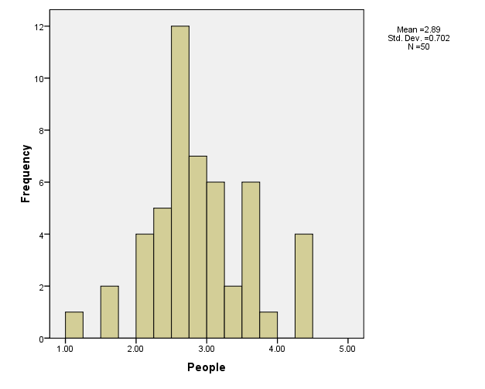
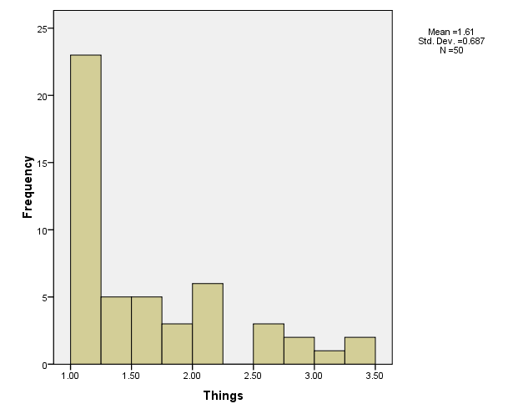
Results cont.
There was a significant correlation between people and things at r(51) = .317 at p = .025

Slide 18
Discussion
Results contradict previous research
Possible reasons for odd data
Participants with poor accuracy?
Average accuracies of less than 80% were excluded in analyses.
Abnormal sample of men?
Abnormal sample of women?

Slide 19
Limitations
Only 12 male participants
Floor effect for thing-oriented occupations
Thing-oriented occupations require less education
Instrument limitations
Notes:
Only average RT for each block was reported, not individual reaction times for each stimulus (word)
IAT software not extremely advanced
Unable to analyze variables in the most accurate and up-to-date way according to Greenwald

Slide 20
Future Directions
More accurate measure of people-things occupation preference
More representative sample
Improved Implicit Associations Tests

Slide 21
Questions?

