Slide 1
Research Methods
How do we know when we know

Slide 2
Outline
What is Research
Measurement
Method Types
Statistical Reasoning
Issues in Human Factors

Slide 3
What is Research
Purpose
To learn something
To base reasoning on evidence instead of merely our own assumptions
Scientific vs. Nonscientific Research
How one gathers evidence
Evidence in:
History
Math
Chemistry

Slide 4
Measurement: General
Definition: to put a number on an observation
e.g.: thermometer, IQ
Why?
Allows easier comparison
The inherent ambiguity of language

Slide 5
Characteristics of Good Measurement
Reliability
Consistency in measurement
Take repeated measures, get same value
Validity
Measure what think measure.

Slide 6
Validity Types
Ecological
Match to situation
Internal:
The study is well designed
The conclusions regarding theory can be made
External:
The results apply to the desired population
Important in Human Factors Research

Slide 7
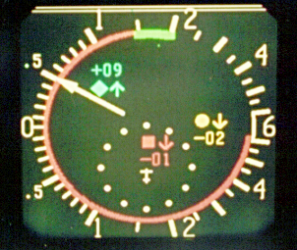
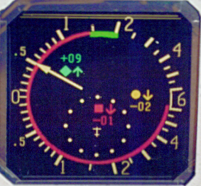
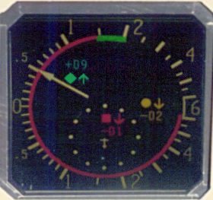
Example: Lighting Study
100 fC Illumination
1000 fC Illumination
10,000 fC Illumination

Slide 8
Method Types
Descriptive
Correlational
Experimental

Slide 9
Descriptive
Why Use?
e.g. Anthropometric data
Archival Data
Observational Methods
Interobserver Agreement

Slide 10
Correlational
Measure patterns of relationship
Prediction
Laws
Correlation does not imply causation
Why?

Slide 11
Scatter Plots

Slide 12
Scatter Plot

Slide 13
Experimental
Manipulation
Independent Variable
Dependent Variable
Causation
Requirements:
Temporal Order
Co-variation (Correlation)
Rule out All Alternatives

Slide 14
Statistical Reasoning
Elements
Variation in Data
Error
Possible influence of IV
Question:
Is variation in data due to error?
Is variation in data due to error and IV?
Sound familiar? Signal Detection Theory

Slide 15
Statistics and Signal Detection Theory
Alpha = criterion
Type I error: probability of concluding there is an effect when there is not one = False Alarm
Use Alpha to set this probability
Type II Error: Probability of not concluding there is an effect when there is one = Miss
Effect Size = d’

Slide 16
Statistical Hypotheses
These are what are tested by stats – not theories
H0: Null Hypothesis: only error is making data vary
Ha: Alternative Hypothesis: error and IV are making data vary
Stats give you p value or sig value = p(H0) is true

Slide 17
Proper uses of Stats
Are they necessary with large effect sizes (d’)?
What do you do if p > alpha?
What do you do if p < alpha?
What does it mean to Reject H0?
Do you ever accept H0?
If you reject H0 have you analyzed your data?

