Slide 1
A Human Information Processing Model after Wickens (1984)
Attentional
Resources
Attentional
Resources
Short-Term
Sensory
Store
Decision
Making
Response
Execution
Perception
Working
Memory
Long-Term
Memory
Memory
Feedback

Slide 2
Attentional Resources General
DEFINITION:
Applying ones mind to something, mental concentration, awareness (Oxford American Dictionary).
Concept becomes necessary because we do not process all stimuli that impinge upon us.
e.g. the cocktail party phenomenon: Listen only to your conversation
e.g. Hearing your name in an adjacent conversation suggests some pre-attentive processing.

Slide 3
Attentional Resources General - 2
Relevant aspects:
It is limited.
Selective Attention: selecting to process some stimuli and not others.
Focused Attention: the ability to, once stimulus is selected, to process that stimulus and not others.
Divided Attention: the ability to process two more more inputs at a time.
Metaphor of the flashlight.

Slide 4
Count the passes by the people in the white t-shirts

Slide 5
A fun version

Slide 6
What’s the point
What do these videos tell us about attention?

Slide 7
Attentional Resources Selective
DEFINITION: The ability to pick one source of information to process (attend) over other sources.
This is the hand that guides the search light.
Information is conceived as coming in from the
world in channels.
A channel is a potential source of information.
Vision vs. audition are channels; within vision or audition, different locations may be different channels, e.g., different dials on dash board.
Can be demonstrated in shadowing.

Slide 8
Attentional Resources Selective - 2
Selective Attention and Multiple Sources
Since cannot attend to all at once, must sample.
Sample source with more event more frequently but P(event)>P(sample).
Thus for source with rare events: P(event)<P(sample).

Slide 9
Attentional Resources Selective - 3
Limits of memory influence how often we sample a channel.
If we do not remember sampling a channel, we forgot, we may return to that channel earlier.
Under stress the range of sampling becomes more narrow and driven by salience.
Thus, under stress, we sample fewer channels.
Choice will be determined by my importance but by the attention getting quality of the channel.
Salience and importance may be similar or not.

Slide 10
Visual Search

Slide 11
Attentional Resources Focused and Divided
Focused Attention: The range of information that will be processed at one time.
Information in the beam of the flashlight.
Relates to ability to ignore irrelevant information.
Divided Attention: The ability to include two or more sources of information and process them simultaneously.
Having the beam fall on two or more
objects.
Ability to handle two or more tasks at once.

Slide 12
Attentional Resources Focused and Divided 2
Channels (How they are defined):
Within a channel information is processed in parallel, that is, at the same time.
In different channels information must be processed sequentially, that is, one after the other.
Notes:
Implications of depth for use of heads up displays - since at different depth will pay attention to one source and ignore the other.
With pitch some evidence by separating male from female voices.

Slide 13
Attentional Resources Focused and Divided 3
A major unit that defines a channel is space
Location defines a channel for both audition and vision.
In shadowing, it is harder to do if both voices come from the same side.
In vision, depth can also define a channel (Neisser and Beckman, 1975).
Pitch may also define a channel for audition.

Slide 14
Space as Definition of Channel

Slide 15
Attentional Resources Focused and Divided 3
Channels (How they are defined, continued):
In vision: the central visual field is about 1 deg.
In all cases, stress narrows the width of the channel, requiring more sampling.
Recall we do not sample as effectively when we are stressed.

Slide 16
Attentional Resources Focused and Divided 4
The effects of Parallel Processing
Two are positive
When two sources of information have independent implications for control, e.g., pilot controlling pitch and roll of a plane.
When two sources of information imply the same action you get redundancy gain.
Two are negative
When the channel capacity is exceeded, e.g., reading two words that are very close together in space.
You want to process only part of the information and the implications of the second source is similar but incompatible to the first source, e.g. the Stroop Effect.

Slide 17
The Stroop Effect
green red blue blue
red green blue yellow
yellow green yellow red
yellow blue green green
blue yellow red red
green red yellow blue
blue yellow blue green

Slide 18
The Stroop Effect
red blue yellow green
yellow green yellow red
blue red green blue
yellow yellow blue green
green red red yellow
blue blue green red
red green blue yellow

Slide 19
The Stroop Effect
yellow blue green red
blue blue red yellow
green red yellow green
blue green yellow blue
yellow yellow red red
red green blue yellow
blue yellow green red

Slide 20
Time Sharing
Time Sharing refers to ability to perform two or more tasks simultaneously.
Refers to ability to handle information from channels that are processed sequentially.
Frequently studied in the laboratory in terms of dual task performance.
Measured by effects on primary or secondary task.

Slide 21
Time Sharing - 2
Leads to concept of Resources.
A resource is a capacity (attention) that can be allocated to a task.
A resource can be allocated in any manner seen fit.
Performance is resource limited, if performance can be improved by increasing attention. Norman and Bobrow, 1975.
Think of what happens when traffic gets heavy.
There may be more than one type of resource for different types of task. Navon and Gopher, 1979.
Thus, dual task performance will increase if do not compete for same resources.
Notes:
Performance may not be limited by skill, but by resources being used.

Slide 22
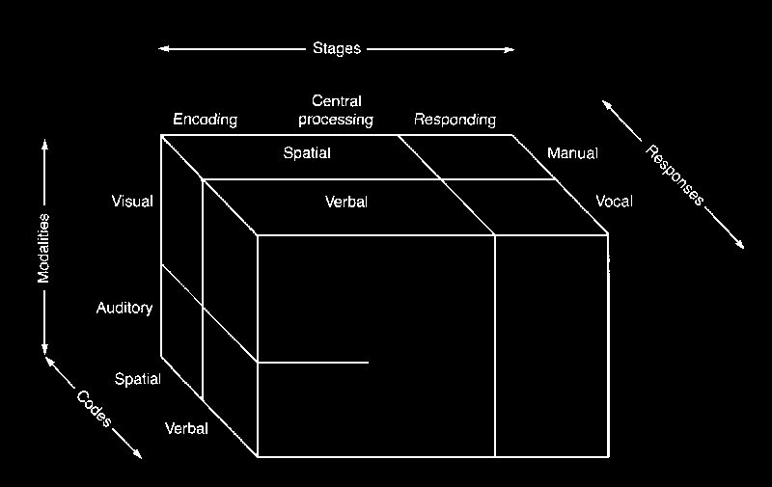
Model of Attentional Resources (Wickens, 1984)

Slide 23
Automaticity
Some tasks do not require attention. They are said to happen automatically.
An example of an inborn automatic function is estimation of short time intervals and direction.
Automaticity may be trained.
Examples
Allport trained piano players to shadowing while playing.
Spelke, Hirst, and Neisser (1976) trained two people over months to simultaneously read for meaning and take dictation.

Slide 24
Automaticity - 2
Automatic functions are said to be processed in parallel.
Thus if information can be trained to be processed automatically, it greatly increases the amount of information a person can process.
It might be like chunking.
It takes great effort to train a function to be automatic.

Slide 25
Visual Search
Two Basic Types
Serial
Search each item one at a time
As add items, search time gets longer
Parallel
Search all at one
As add items search does not get longer
Item is said to “Pop-out”
Wolfe (1999) argues that these are not two types but ends of a continuum.

Slide 26
Decision Making
Estimation
Estimation of the Mean:
E.g., estimating average speed with a fluctuating speedometer
We are not real accurate, but we are not biased.
Estimation of Proportions and Probability:
e.g., estimating how often something happens.
Estimation of extreme proportions, >.90 or <.10 are biased towards moderate proportions.
May be due to salience of rare events.
Estimate salient events as more probable.
Notes:
by biased, it is meant that most estimates are in one direction from the actual value than the other direction.

Slide 27
Decision Making - 2
Estimation (continued):
Estimation of Variability:
E.g., with a fluctuating dial, did the value really change or not?
The larger the mean value the smaller the estimated variability.
Could this be an example of Weber’s Law?
Estimates of variability are driven by the extreme (salient?) values.

Slide 28
Decision Making - 3
Hypothesis Formation and Testing
Can only handle 3 to 4 hypotheses at once.
due to memory limits
Tend to use most highly valued (not the most important) attribute to pare down list of hypotheses.
The Representative Heuristic:
if the data or information in some way resembles the hypothesis, it will be more likely selected.
The base rate fallacy: we ignore probability
Notes:
Could eliminate the correct alternative before test. Then it is hard to come up with the correct hypothesis.
Thus we are selecting the hypothesis that is representative but improbable as opposed the the hypothesis that is less representative but far more probable.

Slide 29
Decision Making - 4
Hypothesis Formation and Testing (continued).
The Availability Heuristic:
A hypothesis easily remembered (available) is given greater weight in decision making.
Availability is driven by factors other than data.
Salience and recency can affect availability.
Confirmation Bias:
in testing hypotheses, we give greater weight to confirming than disconfirming evidence.
We tend to ignore missing evidence.

Slide 30
Try This.
These are index cards.
A
K
4
7
Which cards do you need to turn over to test the
following hypothesis:
If a card has a vowel on it, it has an
even number on the other side.

