Slide 1
The Physical Stimulus for Vision
Light
A form of Electromagnetic Energy
Two Complementary Descriptions
Particle - Photon is unit of light.
Wave - like a wave in ocean
Electromagnetic spectrum
gamma - 10-14 - 10-12
x-rays - -- ~10-9
Ultraviolet -- ~760 nm (>10-7)
° Visual 760-380 nm
Infrared <10-6 - ~10-3
radar -- 10-1
radio bands > over a mile

Slide 2
Measures of Light
Wavelength relates to color, e.g., the spectrum
Usually measured in billionths of a meter - nanometers or nm

Slide 3
Measures of Light - 2
Amplitude = Intensity relates to brightness
Measures use only that light that is effective in stimulating the human eye.
Important types of measures of Amplitude
1. Illuminance - light falling on a surface
2. Luminance - light coming off a surface
3. Reflectance = luminance/illuminance
4. Contrast Ratio = luminance of brightest area/luminance of darkest area

Slide 4
Structures of the Eye
1. Sclera
2. Cornea
3. Aqueous Humor
4. Iris
5. Pupil
6. Lens
7. Ciliary muscle
8. Retina
9. fovea (pit)
10. blind spot/optic disc
11. Pigment Epithelium
Notes:
Sclera - tough outer covering
Cornea - 2/3 focusing power - fixed.
Aqueous Humor - fluid
Iris - gives us our eye color
Pupil is just a hole
Lens - 1/3 power but adjustable
Ciliary muscle - adjusts lens - can tire
Retina - appear thin.
Optic disc - not receptors

Slide 5
The Retina
Two Types of Receptors
Rods
~120 million/eye
night vision
no color
not in fovea
most about 20deg in periphery
Cones
~7 million/eye
day vision
three types so color vision
most in fovea
from Lewis, Zeevi, & Werblin (1969)
Notes:
Discuss the implications of this arrangement.

Slide 6
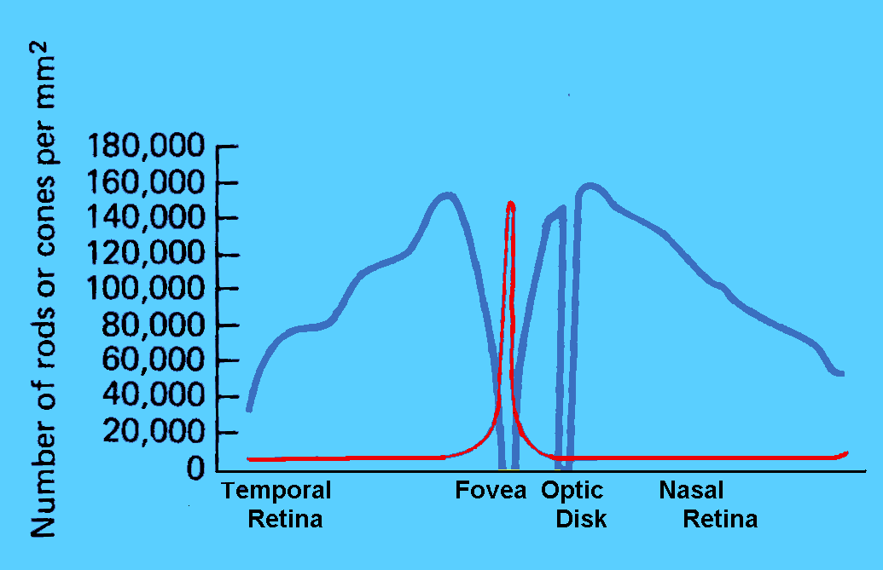
The Retina - 2
Cones
Rods
Data from Osterberg (1935).

Slide 7
Simultaneous Contrast

Slide 8
Mach Bands
Click to add successively lighter bars. Watch the edge to
the right side of the last bar.

Slide 9
Craik-Cornsweet: Filling In

Slide 10
Craik-Cornsweet: Described
The figure above is an exaggerated map indicating the light levels across the image on the previous slide. Note how the center and edges have identical luminance. That can be seen by sitting far enough away from the screen

Slide 11
Minimal Contours

Slide 12
Minimal Contours Described
There are two circles below. Both circles have the same luminance
(intensity level) at the center. Click on your mouse and
This one changes abruptly watch as the edges are blurred
to the level at the center. and the circle disappears.

Slide 13
Accommodation
DEFINITION: The adjusting of the lens thickness to focus at different distances.
Necessary because can only see clearly one distance at a time
Goes very rapidly
Closes can focus in Near Point
Farthest can focus is Far Point
Loose ability to focus as age - moves towards far point
In dark accommodation moves to ~1 meter from face
As fatigue, accommodation moves to this dark focus.

Slide 14
Acuity
DEFINITION: ability to resolve or see fine details.
Visual Angle: DEFINITION: Angle formed by object on retina.
Types of Acuity: what is meant by acuity depends upon the stimulus used to measure it.
Detection: black bar on white field
Resolution: a grating
Recognition: e.g. Snellen, where
you read letters.

Slide 15
Acuity - 2
Measures of Acuity
20/20: can see at 20’ what a normal person can see at 20’.
This is normal, not perfect, vision.
20/200: can see at 20’ what a normal person can see at 200’.
Visual angle of the critical feature in a test, e.g. the width of the bars in a grating.
A typical population average is 1 arcmin (1/60 degree).
Acuity and Retinal Location:
Best at fovea. Falls off rapidly in periphery. Is tied to density of cones.

Slide 16
Contrast Sensitivity
DEFINITION: the minimum contrast ratio that can be detected.
Indicates the smallest difference between shades of gray that can be detected.
Depends on Spatial Frequency
DEFINITION: how many pairs of white and black bars fit into 1 deg. of visual angle.
Low spatial frequency
few bars/deg.
High spatial frequency
many bars/deg.

Slide 17
The Contrast Sensitivity Function
Our sensitivity to contrast depends on this spatial frequency.
Peak sensitivity is 4-6 cycles/degree.
The highest spatial frequency we can see at any contrast is limited by our acuity.

Slide 18
Contrast Sensitivity and Performance
Increasing contrast above threshold will allow for faster identification, up to a point
Beyond a certain contrast ratio - about 3 to 1 or 4 to 1 - increasing contrast ratio has no effect (Krantz, Silverstein, & Yeh, 1992)

Slide 19
Fundamental Limits of Vision
Operating Range of Vision - 1:10¹⁴
if:
1 cent (threshold) =10⁰
Most incomes are between $10,000 and $100,000 = 10⁶ to 10⁷
GNP of U.S.A. for 1 year
= ~10¹⁵

Slide 20
Fundamental Limits of Vision - 2
Duplex Theory of Vision
Two eyes in one. One for day. One for night.

Slide 21
Spectral Sensitivity

Slide 22
Dark/Light Adaptation
Dark Adaptation
The term applied to the increased sensitivity that occurs when we enter a region of lowered sensitivity.
Two phases:
early rapid phase - lasts ~7 minutes and due to cones.
later slower phase - complete in about 30 to 40 minutes due to rods.
Light Adaptation
Takes 2-3 minutes

Slide 23
So Why are Blue Headlights Stupid?

Slide 24
So Why do Nighttime Briefings in Red Light?

Slide 25
Eye Movements
We move our eyes because of the limited field with good acuity.
There are 6 eye muscles
4 rectus
2 oblique
Types of Eye Movements
Version: Both eyes move together
Vergence: Eye move in opposite directions
from Kaiser, 1997,
http://www.yorku.ca/research/vision/
eye/thejoy.htm

Slide 26
Eye Movements - 2
Version
Saccades, most common (link to ESP)
places object on fovea.
can be > 400 deg/sec.
Takes ~ 200 msec to begin
Smooth Pursuit
track moving objects
relatively slow ~30 deg/sec.
Vergence:
Convergence (together) and divergence (apart)
Allows us to look at closer and farther objects.
relatively slow and also takes about 200 msec to begin

Slide 27
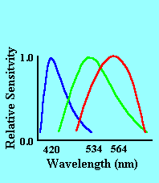
Color Vision I: Color Matching
Dimensions of Color
Hue: refers to the color name we apply.
Saturation: purity of color, to desaturate add white
Brightness:
Trichromatic Theory of Vision
We have three classes of cones
L or red: peak at 564 nm
M or green: peak at 534 nm
S or blue: peak at 420 nm

Slide 28
Color Vision I: Color Matching - 2
Color Matching in the Trichromatic Theory
Two patches of light will appear the same if the activity across the three cones is the same, regardless of wavelengths making up the two patches.
In general, can match any one color with three other colors
This is where we get three primaries.
Neutral colors - whites and grays
a balance of activity across the three receptors.

Slide 29
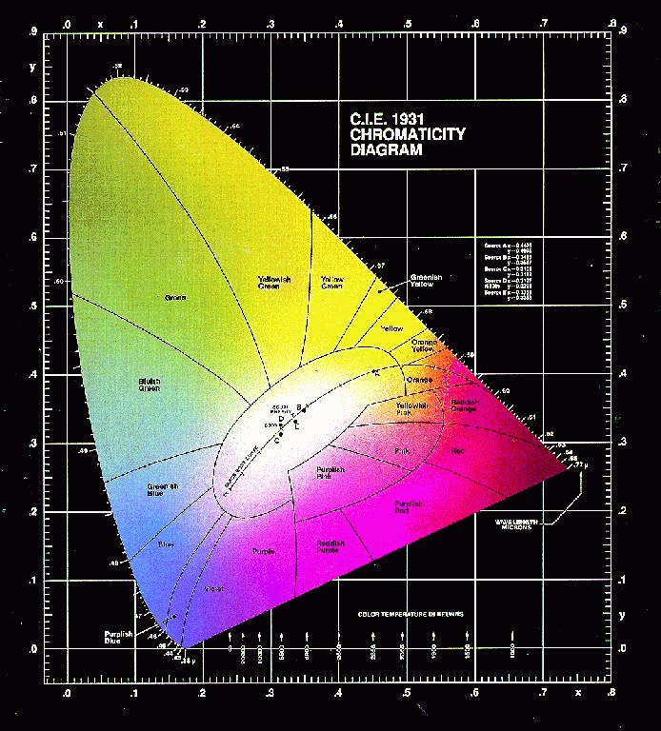
Color Vision I: Color Matching - 3
Formalization of the Trichromatic Theory
By CIE originally in 1931
Based on 300 observers
to develop standard
observer.
A set of Equations that
allow predictions of
matching.
Used in photo printing,
TV and film.
Updates in 1960, 1976

Slide 30
Color Vision II: Color Deficiencies
Most can be understood using Trichromatic Theory
Dichromatism: Missing one of the three cones (link)
Dichromats tend to see through camouflage better than thrichromats
Other Types
Monochromatism: One cone or only rods
Anomalous Trichromats: Three cones but one is different.

Slide 31
Color Vision III: Color Appearance
Color Opponent Theory
Four Primaries: red-green, blue-yellow
Arranged in opposition pairs
Red vs. Green
Blue vs. Yellow
Add on to other get neutral color
Never see a mixture of opposition pairs.
Evidence:
complimentary colors, color aftereffect, simultaneous contrast, color naming - try it with just red, green blue and yellow
Cells in visual system respond this way.

Slide 32
Color Aftereffect

Slide 33
Test Color Aftereffect

Slide 34
Color Vision IV: Resolution
modified from Kaiser, 1997, http://www.yorku.ca/research/vision/
eye/thejoy.htm

Slide 35
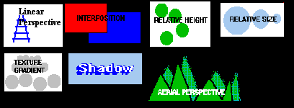
Depth Perception
If retinas are flat (2 dimensional) how do we see depth (the 3rd dimension)?
We use cues: sources of information about depth.
Monocular or one eye cues

Slide 36
Depth Perception - 2
Binocular or two eye cues
Vergence (Only cue to give absolute depth information):
muscular feedback from effort to converge or diverge gives information about depth.
works only for relatively near objects: <20’
Stereopsis (link)
Binocular Disparity: measure of difference of position of an object on the two retinas
DEFINITION: ability to use binocular disparity to see depth.
Basis of 3-D movies
Accuracy of Depth Judgments:
In general, more cues more accurate.

Slide 37
Depth Perception - 3
Size Constancy
DEFINITION: seeing objects as a relatively constant size despite change in retinal image size.
S_{retinal image} α 1/distance to object (α mean proportional to)
S_{perceived} = Constant
Can be quite useful in object recognition
A Variation is Emmert’s Law for after effects
S_{retinal image} = Constant
S_{perceived} α distance
Also applies to depth generated by stereopsis

Slide 38
Depth Perception - 4
To experience Emmert’s Law fixate the center of the dot below for about 45 seconds. Then quickly view the next slide and note the size. Then look at surfaces of different distances, also noting the size.

Slide 39
Depth Perception - 5

