Slide 1
Problem-solving

Slide 2
9 dot problem

Slide 4
Luchins Water Jar Problems
How would you use 3 jars with the indicated capacities to measure out the desired amount of water?
A
B
C
DESIRED
Problem 1
3
77
21
50
Problem 2
8
80
4
60
Problem 3
5
43
12
21
Problem 4
6
42
9
21
Problem 5
3
49
23
20
Problem 6
4
48
18
22

Slide 5
Luchins Water Jar Problems
How would you use 3 jars with the indicated capacities to measure out the desired amount of water?
A
B
C
DESIRED
solution
Problem 1
3
77
21
50
B-C-2A
Problem 2
8
80
4
60
B-C-2A
Problem 3
5
43
12
21
B-C-2A
Problem 4
6
42
9
21
B-C-2A
Problem 5
3
49
23
20
B-C-2A, but also C-A
Problem 6
4
48
18
22
B-C-2A, but also C-A
A simpler solution exists for problems 5 and 6, but subjects reached a
state of “Einstellung” where they kept applying old successful problem
solving methods.

Slide 6
Luchins Results
Group | Einstellung Solution (percent) | Direct Solution (percent) | No Solution (percent)
Control | 0 | 100 | 0
Experimental | 74 | 26 | 0
(Control subjects did not have the first four problems)

Slide 7
True Story
A professor comes to a University to give a talk. They up a slide projector for him, but neglect to test it. During the talk it becomes apparent that the projector is set too low. Graduate students and professors gather around the projector trying to fix the problem. They call out for a book to raise the front end of the projector. The book turns out to be too thick. They call out for a thinner book... While everyone is searching for another book, one person comes over and quietly solves the problem...
Punchline. All these academics in one room, and nobody knows how to open a book??
(from Ashcroft, 2002)

Slide 8
Another problem
A man climbs a mountain on Sat, leaving at daybreak and arriving at the top at sundown. He spends the night, gets up the next day at daybreak and heads down the mountain, following exactly the same path he climbed the day before.
Question: will there be any time during the second day when he will be at exactly the same point on the mountain he was at that time the first day?
B
A
SAT
SUN

Slide 9
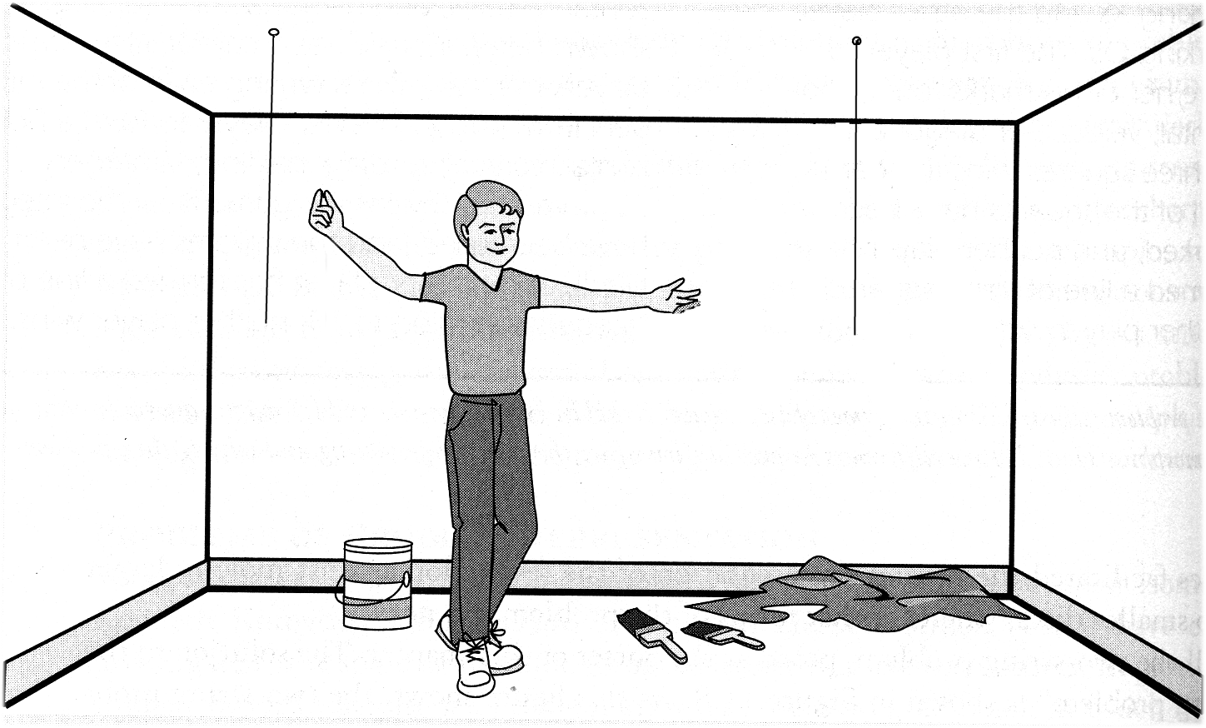
Rigidity in problem solving: Functional Fixedness
Maier’s (1931) two-string problem

Slide 10
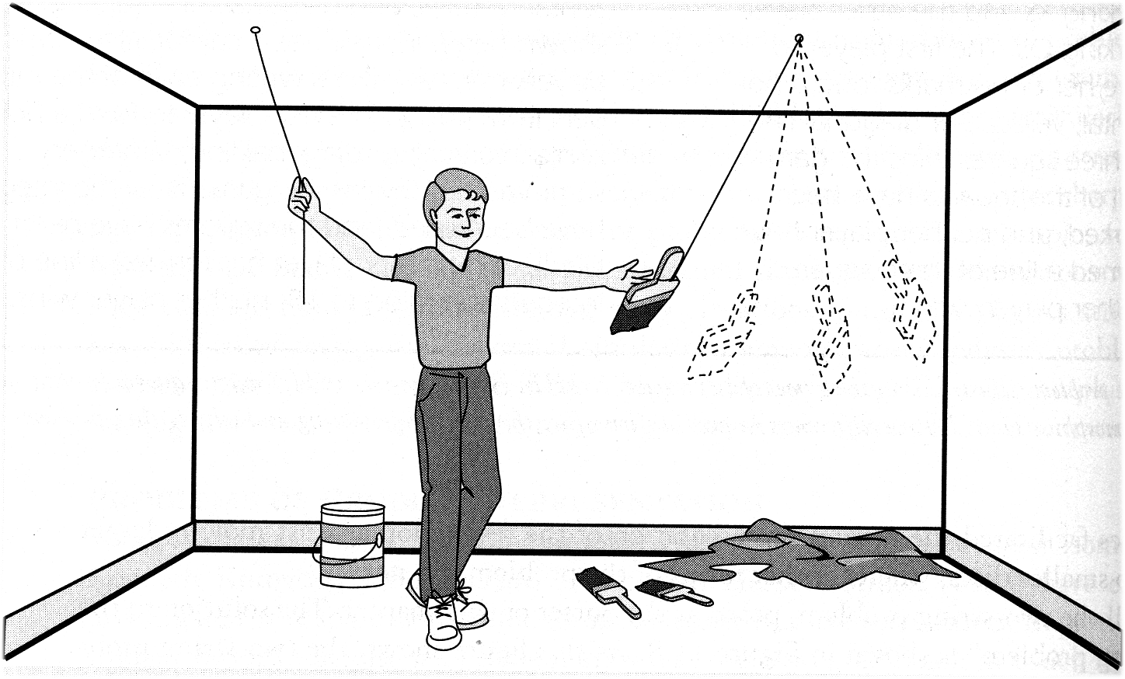
Only 39% of subjects were able to see solution within 10 minutes

Slide 11
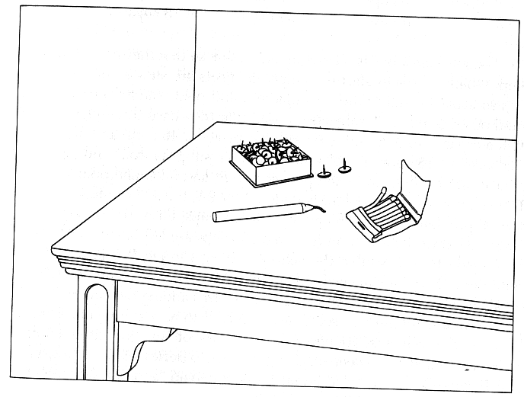
Duncker’s problem: support a candle on a door
A box of tacks, some matches, and a candle

Slide 12
Hat Rack Problem

Slide 13
exposure to the string problem aided performance on the hatrack problem (72% vs. 24% solution)

Slide 14
Try This.
These are index cards.
E
K
4
7
Which cards do you need to turn over to test the
following hypothesis:
If a card has a vowel on it, it has an
even number on the other side.

Slide 15
Monty Hall Problem

Slide 16
Monty Hall Problem

Slide 17
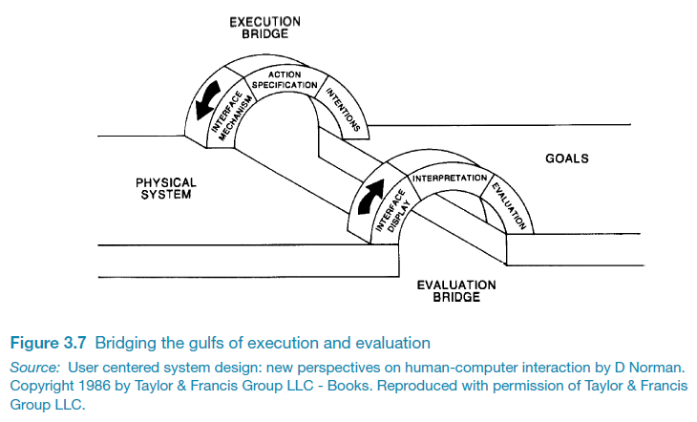
Bridging the gulfs

Slide 18
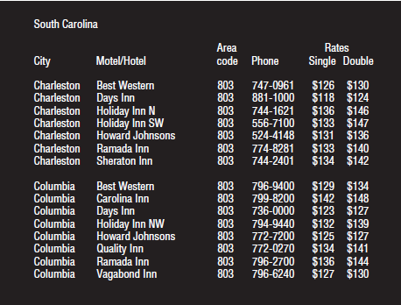
Activity: Find the price of a double room at the Holiday Inn in Columbia

Slide 19
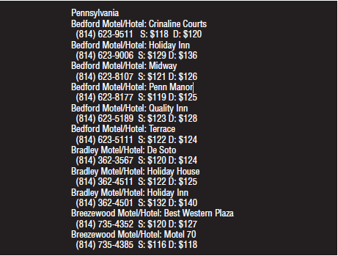
Activity: Find the price for a double room at the Quality Inn in Pennsylvania a

Slide 20
Which was easier and why?

Slide 21
Activity: Apply Sensory
Activities:
  How should we use visual factors to enhance interactions
  Find examples
    Examples of interactions on web or apps that do/do not use contrast well:
    Examples of interactions that use color well or poorly
    Examples of Interactions that use Gestalt laws well
    Examples of interactions in speech that function well or poorly
      Find a sentence that makes the speech recognition breakdown humorously

Slide 22
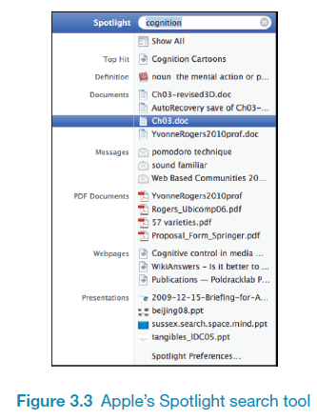
Is Apple’s Spotlight search tool any good?
Notes:
22

Slide 23
Memory aids
SenseCam developed by Microsoft Research Labs (now Autographer)
a wearable device that intermittently takes photos without any user intervention while worn
digital images taken are stored and revisited using special software
Has been found to improve people’s memory, suffering from Alzheimers

Slide 24
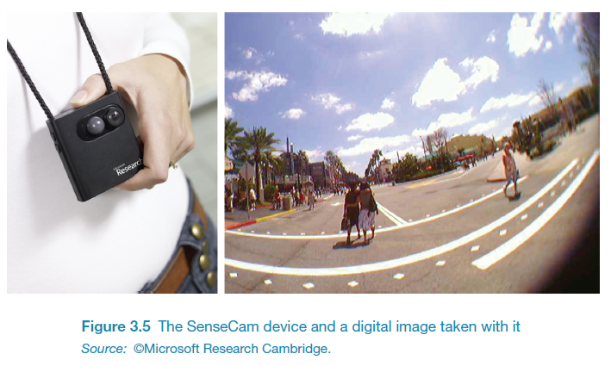
SenseCam

Slide 25
Applications
Speech-recognition systems allow users to interact with them by asking questions
  e.g. Google Voice, Siri, Cortana, Alexa
Speech-output systems use artificially generated speech
  e.g. written-text-to-speech systems for the blind
Natural-language systems enable users to type in questions and give text-based responses
  e.g. Ask search engine

Slide 26
Distributed cognition
Concerned with the nature of cognitive phenomena across individuals, artefacts, and internal and external representations (Hutchins, 1995)
Describes these in terms of propagation across representational state
Information is transformed through different media (computers, displays, paper, heads)
Notes:
26

Slide 27
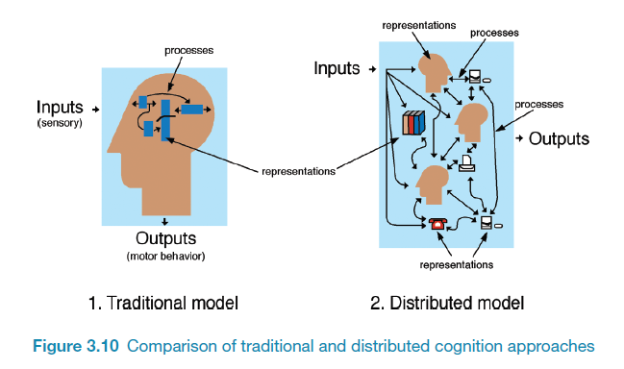
How it differs from information processing
Notes:
27

Slide 28
