Slide 1

How to think about interaction

Slide 2


Slide 3
Recap
HCI has moved beyond designing interfaces for desktop machines
About extending and supporting all manner of human activities in all manner of devices
Facilitating user experiences through designing interactions:
    Make work effective, efficient and safer
    Improve and enhance learning and training
    Provide enjoyable and exciting entertainment
    Enhance communication and understanding
    Support new forms of creativity and expression
Notes:
3

Slide 4
Outline for today
Problem Space
Conceptual Models
Interaction Types
Paradigm, et al.

Slide 5
Problem Space
A representation of the issues and concerns related to the interaction
Must be judged against:
  Requirements
  Job or Task
  System

Slide 6
Understanding the problem space
  What do you want to create?
  What are your assumptions and claims?
  Will it achieve what you hope it will?
Notes:
6

Slide 7

What is an assumption?
taking something for granted when it needs further investigation
  Heads up displays will increase car safety.
Notes:
Wicken’s study with air plane pilots
What are some assumptions you have about people interacting with computers?
Education, experience, knowledge

Slide 8
What is a claim?
stating something to be true when it is still open to question
  Pick a claim from any of your classes:
  What evidence do you have? Where is the issue still open?
Notes:
Writing down your assumptions and claims and then trying to defend and support them can highlight those that are vague or wanting. In so doing, poorly constructed design ideas can be reformulated. Explicating people’s assumptions and claims about why they think something might be a good idea (or not) enables the design team as a whole to view multiple perspectives on the problem space and in so doing reveal conflicting and problematic ones.
8

Slide 9
A framework for analysing the problem space
Are there problems with an existing product or user experience? If so, what are they?
Why do you think there are problems?
How do you think your proposed design ideas might overcome these?
If you are designing for a new user experience how do you think your proposed design ideas support, change, or extend current ways of doing things?

Slide 10
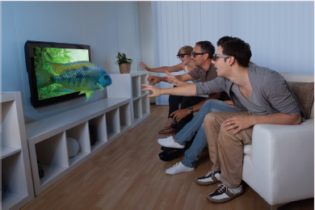

Activity
What are the assumptions and claims made about 3D TV?
Notes:
10

Slide 11
Activity
Problem space for designing an app to
  Schedule classes
  Announce campus activities
  New messaging system for friends
  Find restaurants
  Other possibility?

Slide 12
Conceptual Models

Slide 13
Conceptual model
A conceptual model is:
  “…a high-level description of how a system is organized and operates” (Johnson and Henderson, 2002, p26)
Enables
  “…designers to straighten out their thinking before they start laying out their widgets”
  (Johnson and Henderson, 2002, p28)

Slide 14
Components
Metaphors and analogies
  understand what a product is for and how to use it for an activity
Concepts that people are exposed to through the product
  task–domain objects, their attributes, and operations (e.g. saving, revisiting, organizing)
Relationship and mappings between these concepts

Slide 15
First steps in formulating a conceptual model
What will the users be doing when carrying out their tasks?
How will the system support these?
What kind of interface metaphor, if any, will be appropriate?
What kinds of interaction modes and styles to use?
  - always keep in mind when making design decisions how the user will understand the underlying conceptual model

Slide 16
Activity
Describe the components of the conceptual model underlying a website or app. Present to class
Notes:
These include the placement of items a customer wishes to purchase into a shopping cart or basket and proceeding to checkout when ready to make the purchase. A variation – which is also based on what happens in a physical store – is making a booking, where new items are added, before proceeding to pay.
Making a purchase online is an undertaking with risks and people want to feel they are making the right choice. Designing the interface to have a familiar metaphor (with icon of a shopping cart/basket – although not a cash till!) makes it easier for people to know what to do at the different stages of making a purchase. Importantly, placing an item in the basket does not commit the customer to purchase it there and then. It also enables them to browse further and select other items – as they might in a physical store
16

Slide 17
Activity
Let us develop a conceptual model for our app

Slide 18
Interface Metaphors

Slide 19
Interface metaphors
Conceptualizing what we are doing, e.g. surfing the web
A conceptual model instantiated at the interface, e.g. the desktop metaphor
Visualizing an operation, e.g. an icon of a shopping cart for placing items into

Slide 20
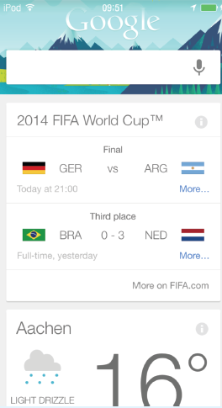

Material Metaphors
The card is a very popular UI
Why?: Has familiar form factor
Material properties are added, giving appearance and physical behavior, e.g. surface of paper
Notes:
Add new image for figure 2.5

Slide 21
Activity
Identify interface metaphors
  Find webpage or app.
  Examine how the app develop use a metaphor from other ways of interaction to develop their interaction
  Identify strengths and weakness of the metaphor
Notes:
Limitation: too stuck to other types of interactions. E.g., online surveys. Likert Scale vs. Visual Analog Scale: get an image

Slide 22
Activity
What interface metaphors do we want on our app?

Slide 23
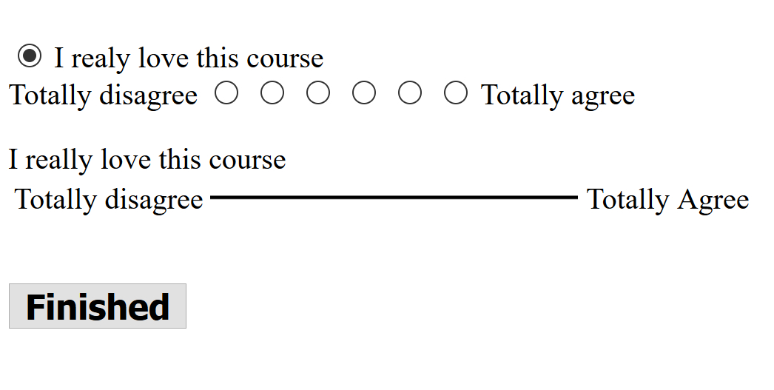
Likert vs. Visual Analog Scale

Slide 24
Interaction Types

Slide 25
Interaction types
Instructing
  issuing commands and selecting options
Conversing
  interacting with a system as if having a conversation
Manipulating
  interacting with objects in a virtual or physical space by manipulating them
Exploring
  moving through a virtual environment or a physical space
Notes:
25

Slide 26
Activity
Find at least one example of each type of interaction
  Instructing
  Conversing
  Manipulating
  Exploring

Slide 27
Activity
What interaction type do we want for our app?

Slide 28
Conceptual models: interaction and interface
Interaction type:
  what the user is doing when interacting with a system, e.g. instructing, talking, browsing or other
Interface type:
  the kind of interface used to support the mode, e.g. speech, menu-based, gesture

Slide 29
Many kinds of interface types available including…
Command
Speech
Data-entry
Form fill-in
Query
Graphical
Web
Pen
Augmented reality
Gesture

Slide 30
Which interaction type to choose?
Need to determine requirements and user needs
Take budget and other constraints into account
Also will depend on suitability of technology for activity being supported
This is covered in course when designing conceptual models

Slide 31
Activity
What types of interaction elements do we want for our app and what should they do?

