Slide 1
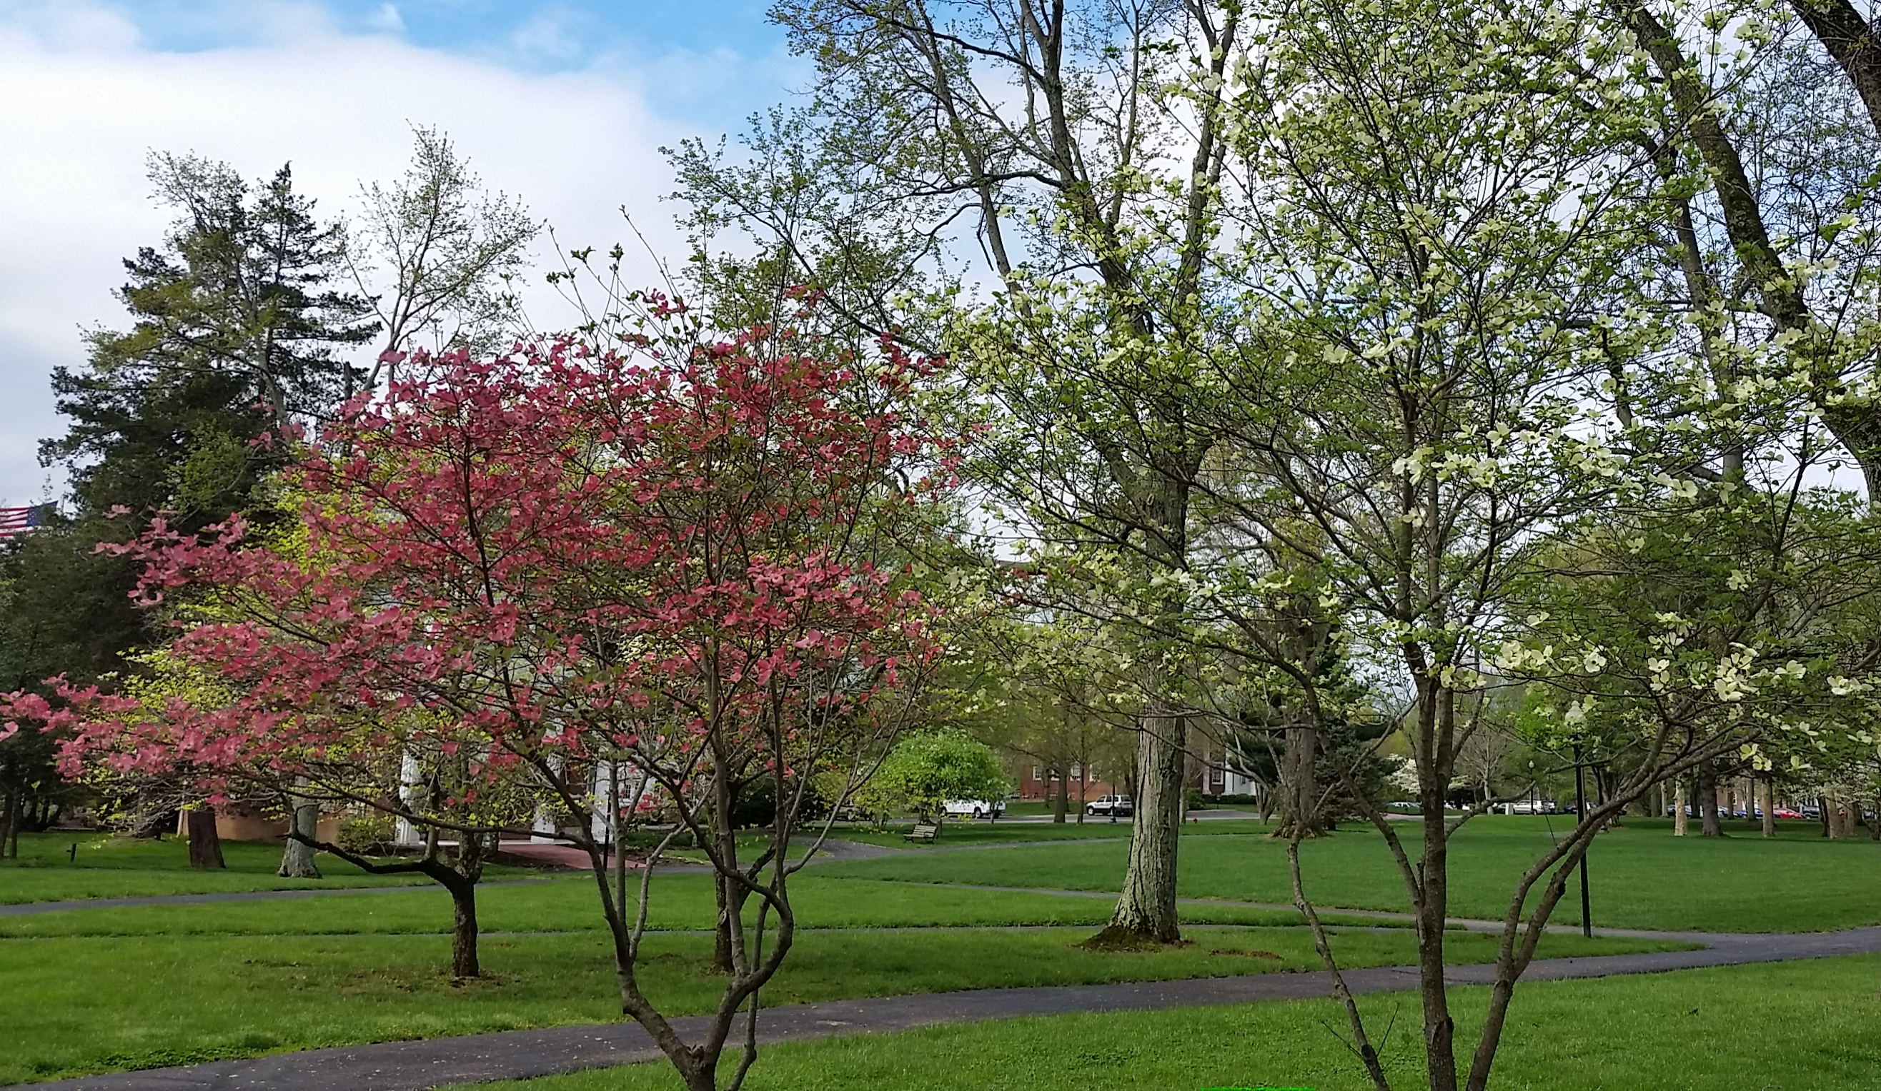
Spring is Finally Here!
Notes:
Outline.
New audience so I don’t know your background. Apologize but I have found this useful information when talking about related topics.
I want to give you context to understand the uses of the page.

Slide 2
Psy/CS 260 Human-Computer Interaction
Honor Thy User
There are Always Tradeoffs

Slide 4
Which is hot water and which is cold water?
Why doesn’t it matter?

Slide 5
Oh.
But is this true everywhere?

Slide 6
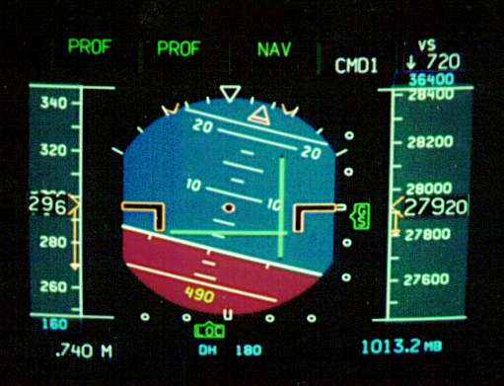
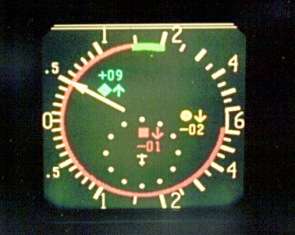
There are always tradeoffs
100 fC Illumination
CRT
LCD

Slide 7
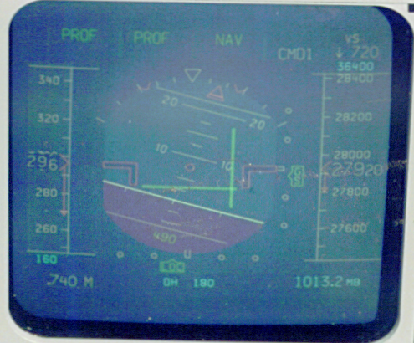
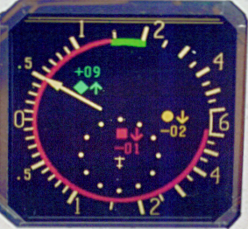
There are always tradeoffs
1000 fC Illumination
CRT
LCD

Slide 8
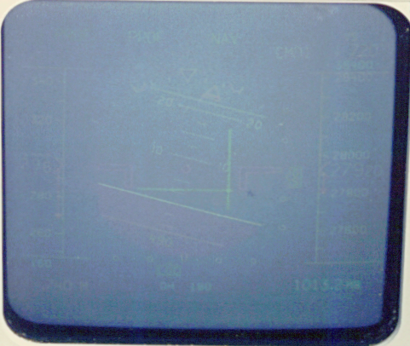
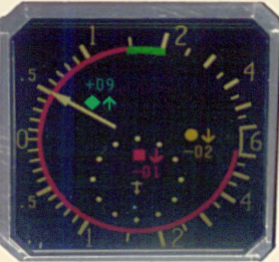
There are always tradeoffs
10,000 fC Illumination
CRT
LCD
LCD looks a lot better doesn’t it? But …

Slide 9
Detailed Description of Three-Mile Island
4:00 am, March 28, 1979
Main feedwater pump stops due to a polisher blocking coolant flow
due to resin build up.
Resulting Hardware Effects and Actions:
Electrical generators and turbines shut down.
Temperature of water in the reactor rises.
Pressure in reactor water builds and escapes from relief valve.
control rods automatically drop stopping the nuclear reactions.
emergency feedwater pump starts
This should have been a mild failure - unworthy of news attention.
Notes:
The hardware effects and actions were expected and normal. All started out according to plan expected by the engineers- it was humans who stepped in and messed up the system. But why they stepped in is understandable as will be seen below.

Slide 10
Three Mile Island - The Disaster
Mechanical Failure
NO water was getting to the emergency pump - the lines were closed
one light signaling that lines were closed was covered by a maintenance tag.
other light - who knows?
The relief valve did not close
With valve open, radioactive water escaped to drain tank.
Human Factors Issue
Visibility of alerts
Placement is also an issue
Relief valve lights indicated commanded state not actual state - that they were switched to close that that they did close
Notes:
The relieve valve did not close
The relief valve could have been manually closed but the operator could not tell if the valve was open only that the power to the valve was off .
With over 100 alarms going off - think - what is the supposed limit of short term memory - 7+-2.

Slide 11
Three Mile Island - The Disaster - 2
Action
Over 100 alarms went off in two minutes
Computer printer was hopelessly behind the times - 1 item every 4 seconds.
Human Factors Issue
Limits of Short-term memory
Limits of attention
Response selection

Slide 12
Three Mile Island - The Disaster (cont.)
When the steam generators boiled dry standby pumps began to operate, as they should
Operators turned down the flow thinking enough coolant was available - kept problem growing.
Practically an accidental turning on of the standby pumps by a supervisor averted the accident.

Slide 13
Three Mile Island - Summary
Human intervention was primary cause of accident
But the reasons for the errors by the operators predate the building of the plant
The Human Error was principally due to design of the control room
Note: While there was human error, it was not the operators fault
A recent change in shift may also have played a role.

Slide 14
A Minor Disaster Closer to Home
Background
Oven controls are not standard - off on different ovens are different directions.
The previous oven control turned counter-clockwise for off.
The oven under consideration turned clockwise for off.
The Event
A very nice apple crisp was being made.
It had completed it before supper.
It got very crisp - turned on broiler instead.
The nonstandardized controls between units led to proactive interference.
Notes:
what happened is that when she tried to turn off oven to keep it warm until supper was over, she was in a hurry so she - - - - extra-crispy.

Slide 15
Bad Design: Why?
Find your own examples

Slide 16
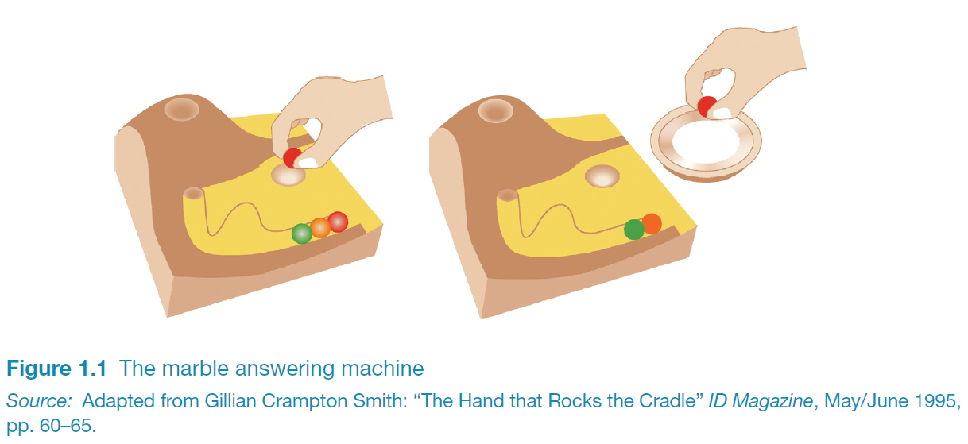
Is this a good design?
Be critical readers of the text, especially the examples.

Slide 17
Good Designs?
Find some examples

Slide 18
Overview of Key Human-Computer Interaction Concepts
The Task or Job
DEFINITION: Any behavior with a goal.
For example:
What are the tasks of a car?
What are the tasks of a word processing program?
What are the tasks of a computer?
System: All elements
involved in task or job.
Goal State: Desired conditions
Current State: Present conditions

Slide 19
Overview of Key Human Factors Concepts
The System
DEFINITION: a set of connected things or parts that form a whole or work together. (Oxford American Dictionary)
A system is what performs the task or job

Slide 20
Overview of Human-Computer Systems
Muscular Feedback
Cognitive Functions
Sensory Systems:
Human Input
Motor Functions:
Human Output
The Human-Machine Interface
Displays:
Machine Output
Controls:
Machine Input
Feedback within Machine
Mechanisms of Machine:
Performs Task and Determines State

Slide 21
Implications of the System Concept (after Proctor and van Zandt, 1994)
The user or operator is part of the system
The system goals are superordinate
Know the purpose of the system.
Systems are usually hierarchical
Both systems and components have inputs and outputs
Know the structure of the system
Deficiencies in system performance is the result of deficiencies of one or more components.
The system is part of the larger environment

Slide 22
What is User-Centered design
Need to take into account:
Need to optimize the interactions users have with a device:

Slide 23
What is interaction design?
“Designing interactive products to support the way people communicate and interact in their everyday and working lives.”
Preece, Sharp and Rogers (2015)
“The design of spaces for human communication and interaction.”
Winograd (1997)

Slide 24
HCI and interaction design

Slide 25
Working in multidisciplinary teams

Slide 26
The User Experience
How a product behaves and is used by people in the real world
Cannot design a user experience, only design for a user experience

Slide 27
What is involved in the process of interaction design
Establishing requirements
Developing alternatives
Prototyping
Evaluating

