Slide 1
Personality Types and their Relation to Pet Preference
Kristina Donnelly – Brotzman
Slippery Rock University

Slide 2
Personality Types
EXTROVERTS: enthusiastic, talkative, assertive, gregarious
INTROVERTS: reserved, non-confrontational, listener, unsociable
TYPE A: ambitious, organized, status conscious, impatient, workaholic, higher risk for developing coronary heart disease
TYPE B: steady worker, low stress, non-competitive, reflective, low risk for developing coronary heart disease

Slide 3
Background
Type A Personalities have a higher risk of developing coronary heart disease (CHD) than Type B (Alteration of type A behavior and its effect on cardiac recurrences in post myocardial infarction patients, Friedman, et al, 1986)
Sufferers of CHD have a better survival rate after being discharged if they own a pet (Animal Companions and One-Year Survival of Patients After Discharge From a Coronary Care Unit, Friedmann et al, 1980)
Introverts and Extroverts were measured based on the Meyers-Briggs type indicator scale (Meyers-Briggs et al, 1962)
Type A and Type B Personalities were measured based on the Jenkins Activity Survey (Jenkins et al, 1974)

Slide 4
Background (cont’d)
Owning a pet does not have an effect on a person’s self esteem or level of extroversion (Personality Characteristics and Self Esteem in Pet Owners and Non-Owners, Johnson et al, 1991)
“Dog people” are more extroverted than “Cat people” (Personalities of Self-Identified “Dog People” and “Cat People”, Gosling et al, 2010)
Pet owners are more emotionally attached to their favorite pet than other animals, and that attachment grows stronger as more time passes (Pet Attachment and Personality Type, Bagley et al, 2005)
Results were analyzed using a Chi Squared test, as the data was nominal.

Slide 5
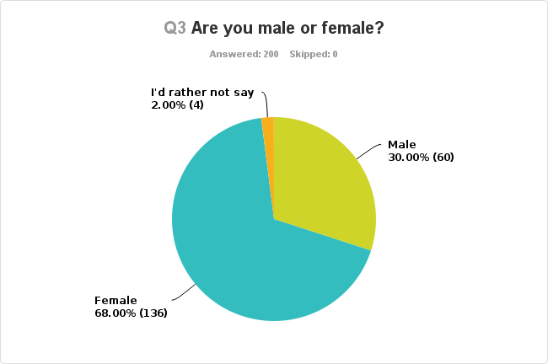
Participants

Slide 6
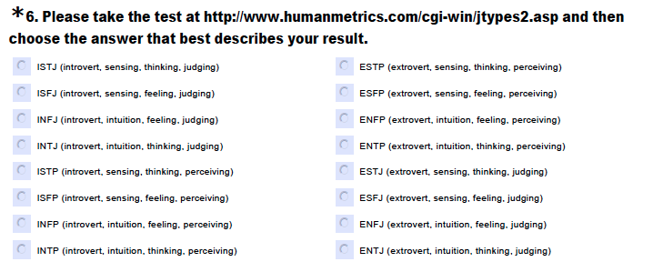

Slide 7
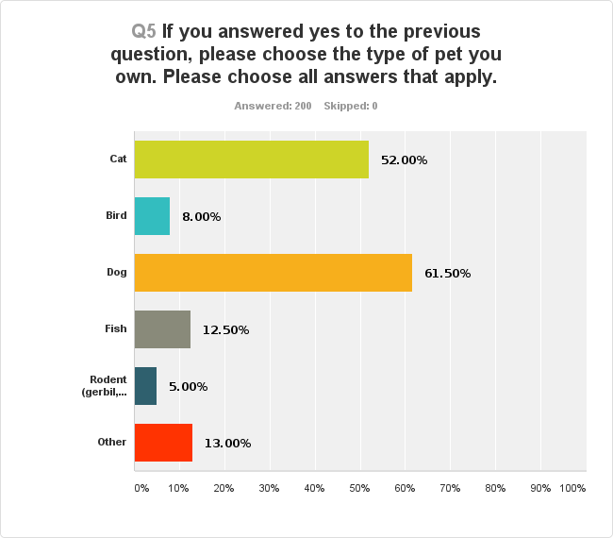
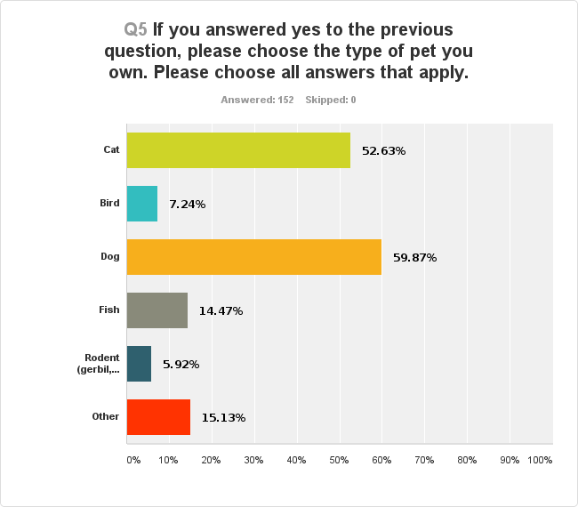
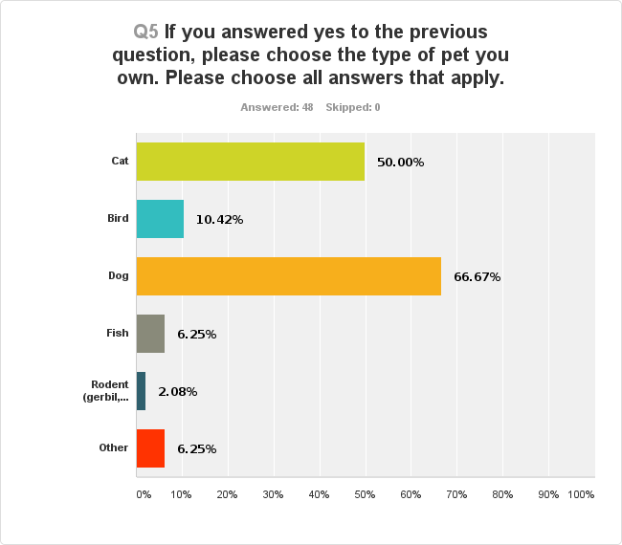
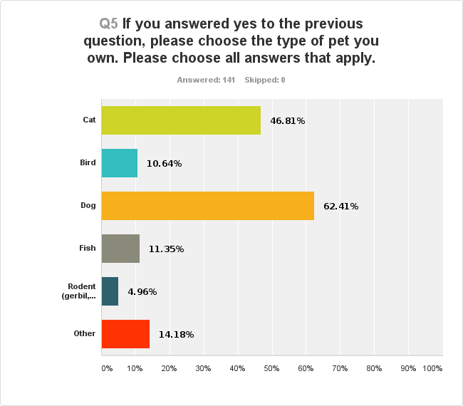
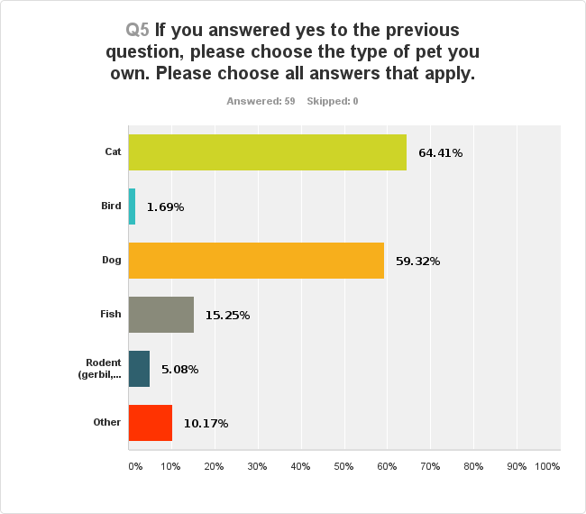
ALL RESPONSES
INTROVERTS
EXTROVERTS
TYPE A
TYPE B

Slide 8
All
TYPE B
Cats
χ² (1, N = 38) = 5.16, p = .023
Birds
χ² (1, N = 1) = 4.52, p = -.033

Slide 9
Hypotheses
Cats are low demand and low control animals, while birds are high demand and require a good amount of control, so Type B personalities who already lead a low stress lifestyle, may be attracted to cats more so than birds for this reason.
The calm and laidback lifestyle a cat tends to have may help relax people, leading to a lower stress level in life.
Owning a cat may reduce the chances of developing a coronary heart disease.

Slide 10
Annual Costs
Heart Disease | Cost | Cat | Cost
Coronary Heart Disease | $1.3* | Annual costs (Food, litter, healthcare, toys) | $670
Heart Attack | $250.1** | One time costs (Spay/neuter, carrier, litter box) | $365
* Billion
** Million

Slide 11
Conclusions
Type B Personalities, or people at a lower risk for developing coronary heart disease (CHD) prefer cats.
This presents the possibility for further investigation into whether introducing a cat to a Type A personality, or someone more likely to develop coronary heart disease could possibly lower their chances of developing heart disease.

Slide 12
References
Bagley, D. K., & Gonsman, V. L. (2005). Pet attachment and personality type. Anthrozoos: A Multidisciplinary Journal of The Interactions of People & Animals, 18(1), 28-42. doi: 10.2752/089279305785594333
Blumenthal, J. A., Williams, R. B., Kong, Y., Schanberg, S. M., & Thompson, L. W. (1978). Type A Behavior Pattern and Coronary Atherosclerosis. Circulation, 58(4), 634-639. doi: 10.1161/01.CIR.58.4.634
Friedman, M., Thoresen, C. E., Gill, J. J., Ulmer, D., Powell, L. H., Price, V. A., ... Dixon, T. (1986). Alteration of type A behavior and its effect on cardiac recurrences in post myocardial infarction patients: Summary results of the recurrent coronary prevention project. American Heart Journal, 112(4), 653-665. doi: 10.1016/0002-8703(86)90458-8
Friedmann, E., Katcher, A. H., Lynch, J. J., & Thomas, S. A. (1980). Animal Companions and One-Year Survival of Patients After Discharge From a Coronary Care Unit. Public Health Reports, 95(4), 307-312. Retrieved April 17, 2014, from http://www.ncbi.nlm.nih.gov/pmc/articles/PMC1422527/
Gosling, S. D., Sandy, C. J., & Potter, J. (2010). Personalities of Self-Identified “Dog People” and “Cat People”. Anthrozoos: A Multidisciplinary Journal of The Interactions of People & Animals, 23(3), 213-222. doi: 10.2752/175303710X12750451258850
Johnson, S. B., & Rule, W. R. (1991). Personality Characteristics and Self-Esteem in Pet Owners and Non-Owners. International Journal of Psychology, 26(2), 241-252. doi: 10.1080/00207599108247889
Shah, S. U. (2004). Heart and mind: (1) relationship between cardiovascular and psychiatric conditions. Postgraduate Medical Journal, 80(950), 683-689. doi: 10.1136/pgmj.2003.014662
Pet Care Costs. (n.d.). Retrieved April 24, 2014, from http://www.aspca.org/adopt/pet-care-costs
Heart Disease Facts. (2014, February 19). Retrieved from http://www.cdc.gov/heartdisease/facts.htm
Population Clock. (n.d.). Retrieved from https://www.census.gov/popclock/

