Slide 1
The Effect of Sense Manipulation on Postural Stability
By: Kyle Bohnert and Rachael Moreland
Hanover College

Slide 2
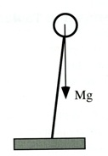
Posture
Body thought of as an inverted pendulum
Very Unstable
Small area of support in which the COM must fall
Posture
Considered to be a dynamic

Slide 3
Posture Cont.
There are three main sensory inputs that help control posture
Vestibular
Visual
Somatosensory
Notes:
Vestibular system aids with motion sense… reason why people have motion sickness. Balance of fluid in tubes is off.
Ocular system makes a person visually aware of their surroundings, alerting them to their posture in relation to what they are able to see in their surrounding world.
Somatosensory alerts people to what they feel, without this it would be difficult for a person to know

Slide 4
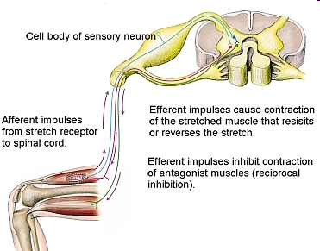
Somatosensory System.
http://www.thestretchinghandbook.com/archives/myotatic-stretch-reflex.php

Slide 5
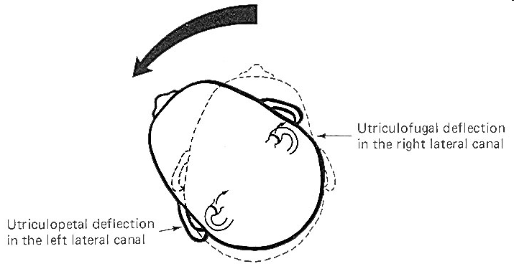
Vestibular System
www.humanneurophysiology.com
Notes:
The rotation test allows maximum stimulation of the horizontal and vertical canals.
Maximum deflection of the cupola of a particular canal occurs when the movement of the head is in the same plane as the canal which contains that cupola.
This is accomplished in the swivel chair by placing the head in various positions and then rotating the chair.

Slide 6
Visual System

Slide 7
Research Question
We are interested in discovering what will happen with posture when more of our senses become impaired
Notes:
Visual: Without the visual system you could never be certain of your surrounding environment. It is the system that uses the most information (largest area of brain). However also, in the study mentioned above an actual decrease in postural sway was seen due to their ability to compensate using the other systems.
Vestibular System: Without this system you would not have an appropriate sense of gravity or bodily orientation.
Somatosensory System: Without this system you would not be able to feel, you would not have reflexes, it is the quickest system to respond to the surrounding world.

Slide 8
Participants
Hanover College Students
13 Participants
Males = 6
Females = 7
Age range = 18-22
Average = 20
No known postural deficits, visual defects beyond that which can be fixed by glasses, vestibular or somatosensory defects

Slide 9
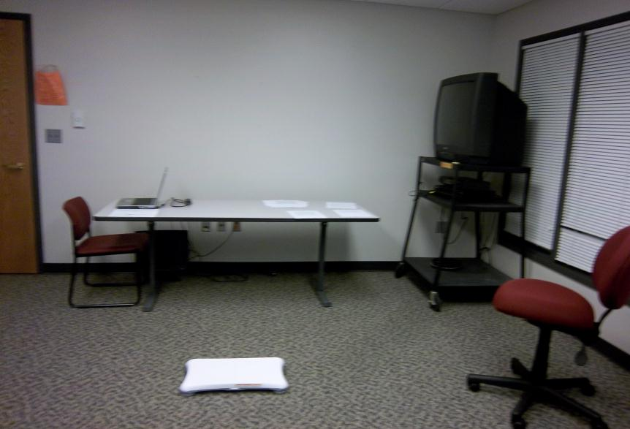
Room/Equipment

Slide 10
Protocol
YYY | YNY
YYN | YNN
NYY | NNY
NYN | NNN
2 X 2 X 2 Study
Somatosensory
YES NO
VISION VISION
YES NO YES NO
YES
VESTIBULAR
NO
Notes:
Separate days!!!
Somat=ice
Visual=eyes closed
Vest = spin

Slide 11
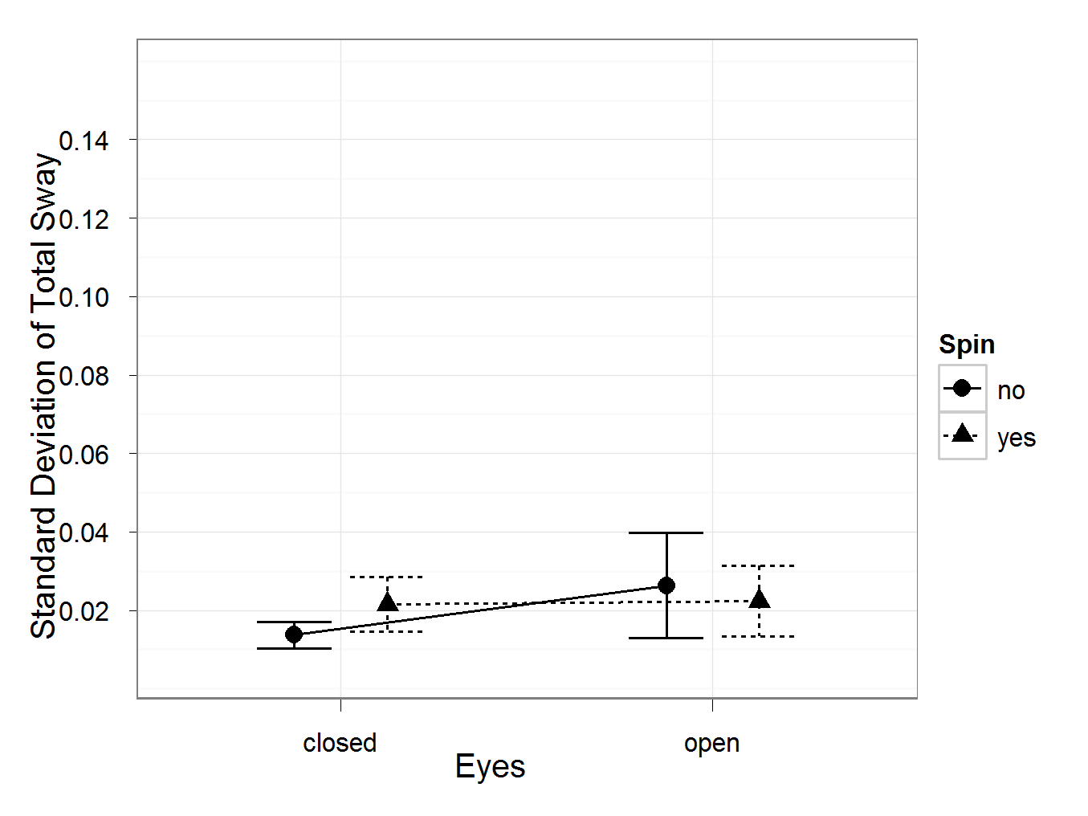
Overall Standard Deviation
P = 0.066

Slide 12
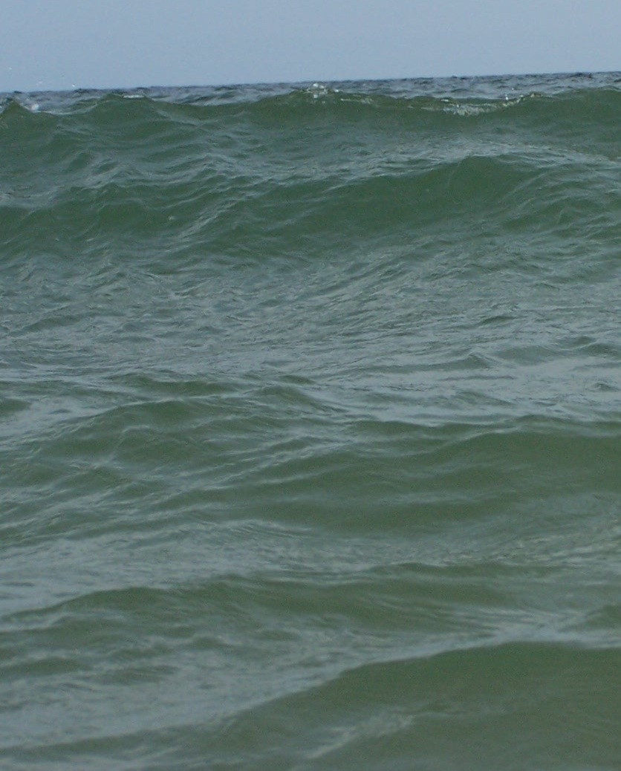
Levels of Sway Frequency

Slide 13
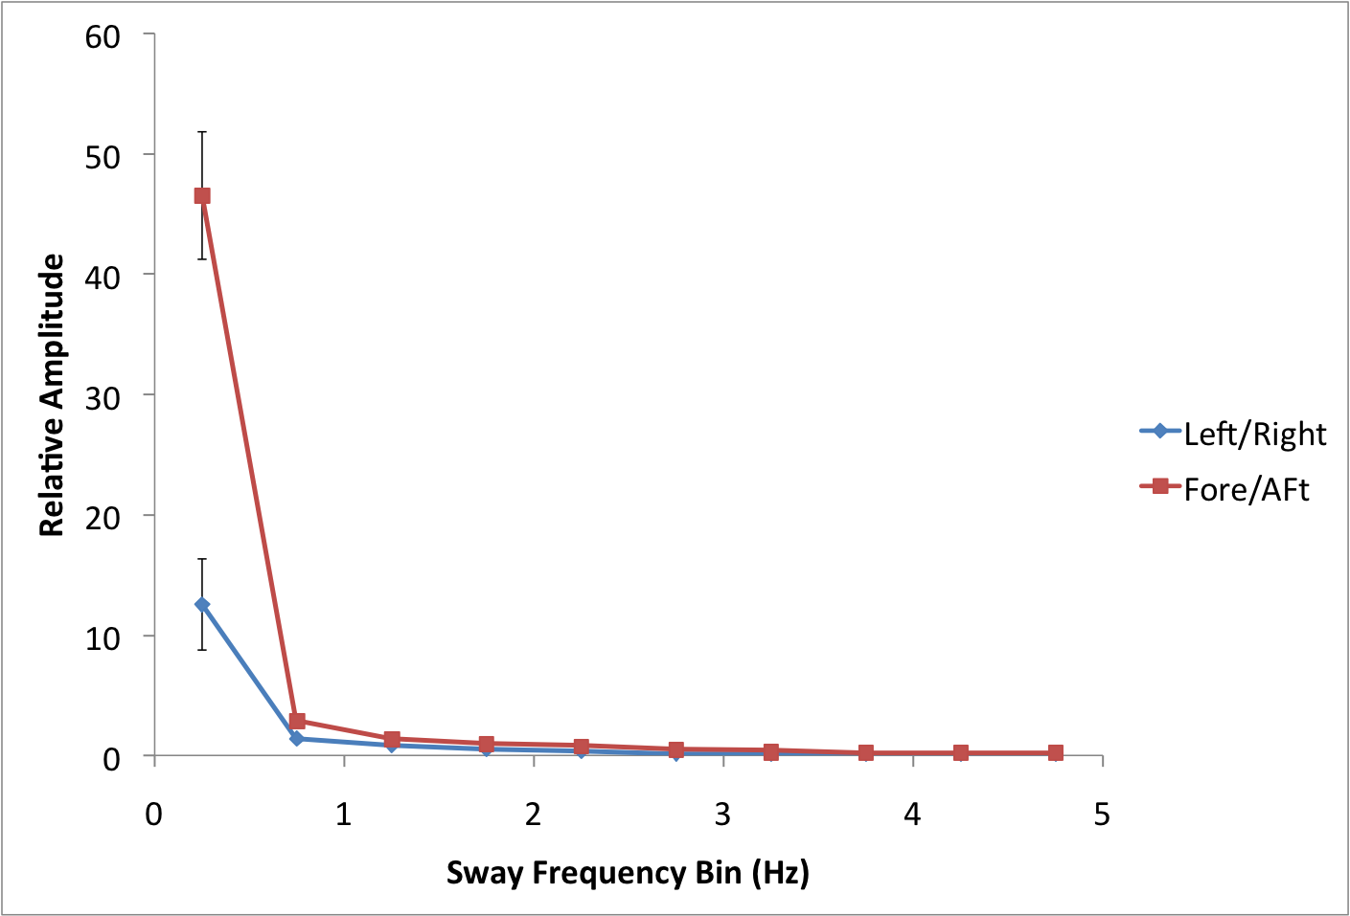
Control FFT

Slide 14
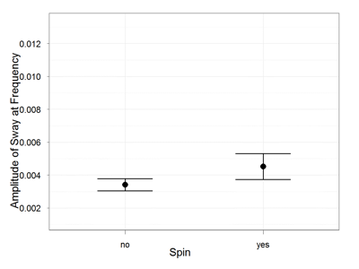
Results Low Frequency (0.5-1.5HZ)
F(1,11)=1.00
P < 0.05

Slide 15
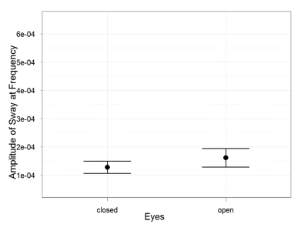
Results High Frequency (4.25-4.75HZ)
F(1,11)=4.785
P < 0.05

Slide 16
Discussion Low Frequency
Main effect for spin
After spinning, the fluid in the semi circular canals provides false information
Sense of continual motion
3 possible explanations
Effected by rate at which spun
The way vestibular system works
Optimal frequency for vestibular.
Notes:
Swayed more when spun before hand

Slide 17
Discussion High Frequency
Main effect for vision
Participants swayed less with eyes closed than with eyes open.
Similar to results seen by Kinsella Shaw (2006)
However just seen in high frequency
Visual Fixation Task (Stoffregen, 2007)
Sway less = more at high frequency

Slide 18
Discussions
Limitations
Number of participants.
Randomizing the order of icing and spinning conditions.
Diverse group
Age range
Athletes vs Non-Athletes

Slide 19
Questions?

