Slide 1
Linking Perceived Attractiveness and Relationship Status: Categorization in Mate Selection
Andrew Pennington and Nathan Hickman
Hanover College

Slide 2
Linking Attractiveness and Other Traits
Attractiveness → Other Traits
What is Beautiful is Good
(Dion, Berscheid, and Walster)
Other Traits → Attractiveness
What is Good is Beautiful
(Gross and Crofton)
Notes:
ME

Slide 3
Benefits of Attractiveness
Applied Benefits
Relative Importance of Applicant Sex, Attractiveness, and Scholastic Standing in Evaluation of Job Applicant Résumés
(Dipboye, Fromkin, and Wiback)
Differential Payoffs
(Udry and Eckland)
Men: Occupation and Mobility
Women: Marriage to Well-off Gentlemen
Notes:
Nate

Slide 4
How Others’ Perceptions Shape Our Perceptions
Contrast Effects and Judgments of Physical Attractiveness: When Beauty Becomes a Social Problem
(Kenrick and Gutierres)
Notes:
Andrew
Specifically their 3rd Experiment
When others express that an individual is attractive, one is more likely to also view that individual as attractive

Slide 5
Comparison Study
The Effect of Relationship Status on Perceived Attractiveness
Different Method
Conclusion Comparison
No control group
(O’Hagen, et al.)
Notes:
ME

Slide 6
Hypothesis
Ratings of attractiveness will be higher for individuals who are presented as being in long-term relationships.
Based upon belief that those in relationships possess certain relationship skills making them more desirable and thus perceived as more attractive
Notes:
Both

Slide 7
Pilot Study: Method
Stimuli: Pictures of 87 Hanover College Students, (45 male, 42 female)
Participants: 76 with ages 18-60 yrs. old
Procedure: Each participant rated the attractiveness of 22 or 21 stimuli on a six-point Likert scale
Notes:
Nate Discuss obtaining facial photographs

Slide 8
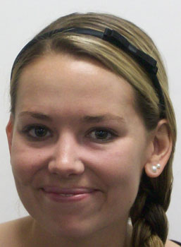
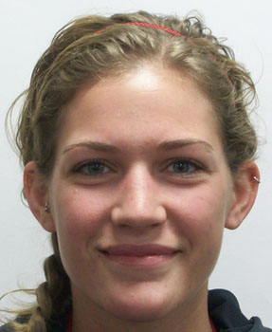
Notes:
Nate

Slide 9
Assigning Attractiveness Levels
Notes:
Nate

Slide 10
Variables
Independent
Level of Average Attractiveness
Relationship Status
Gender of Presented Face
Dependent
Rating of Attractiveness
Disguising the Dependent Variable
Ex. “How anxious is this person?”
Notes:
Nate
Explain levels for IVs

Slide 11
Method
Participants: 103 females aged 18-24 yrs., acquired online
Stimuli: 12 images from pilot study (6 male, 6 female), one of each gender presented to each participant
Pseudonym, Date of Birth, and Hometown randomly assigned along with one of three relationship statuses
Ex. “Matthew Johnson was born on February 2nd in the town of Galena, CA and is currently in a relationship of at least three months.”
Notes:
Disguising the Dependent Variables: Add in questions like “How happy is this person?” and “How intelligent is this person?”, Comparison Variables: Personal Income ME Informed consent: Explain scenario

Slide 12
Procedure
Informed Consent and Scenario
“We are interested in how people make first impressions. We will be asking you to rate two individuals on several factors.”
Rating of Stimuli
Demographics
Debriefing

Slide 13
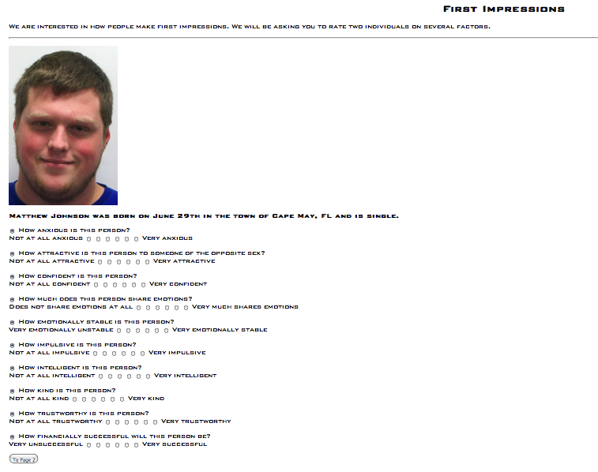
Notes:
ME

Slide 14
Notes:
ME

Slide 15
Analysis
2x3x2 ANOVA
Comparison Variables
Gender Differences
Notes:
ME

Slide 16
Main Effect of Attractiveness Condition
F(1, 112) = 25.015, p = .000
Notes:
ME

Slide 17
Main Effects of Relationship Status and Gender of Face
Relationship Status
F(2, 112) = .204, p = .816
Gender of Face
F(1, 112) = 11.864, p = .001
Women rated men on average as more attractive than other women
Notes:
Nate

Slide 18
Significant Interactions
Gender of Face and Attractiveness Condition
F(1, 112) = 5.458, p = .021
Gender of Face and Relationship Condition
F(2, 112) = 3.051, p = .051
Notes:
Nate
Face Gender and Attractiveness Condition: Both main effects were statistically significant, thus, we see a statistical significance of their interaction

Slide 19
Interaction of Attractiveness Condition and Gender of Face
F(1, 112) = 5.458, p = .021
Notes:
F = 5.215, p < .05
ME

Slide 20
Interaction of Gender of Face and Relationship Condition
F(2, 112) = 3.051, p = .051
Notes:
F = 3.339, p < .05
ME

Slide 21
Discussion
Effective manipulation of attractiveness level through the use of the pilot study
Did not find a statistically significant main effect of Relationship Status
Were not able to prove or disprove our hypothesis
Interaction of Gender of Face presented and Relationship Status
Found results that linked perceived attractiveness and financial success
Notes:
Nate
FaceGender*RelCON= suggests difference in the way that an individual rates attractiveness of their own gender and the opposite gender when considering relationship status

Slide 22
Limitations
Unable to examine the effect of participant gender
Could have included open-ended questions about how individuals chose the ratings they did for the stimuli
Notes:
ME
1/3 of sample male

Slide 23
Fin
Questions?
Notes:
Both

