Slide 1
The Short-Term Effects of Animal Assisted Therapy on Pediatric Hospital Patients
Aislinn Cooper & Griffin Liford

Slide 2
Purpose and Types of AAT
Animal assisted therapy is designed to promote improvement in human physical, social, emotional, and/or cognitive functioning. (Delta Society).
Three major types of animal asissted therapy:
-Dolphin assisted therapy
-Equine Therapy
-Pet Therapy

Slide 3
Historical Uses
Animals first used therapeutically by the Quakers in 1792 at the York Retreat.
Notable psychologists used own pets:
Freud: Jo-Fi
Boris Levinson: Jingles
Coined term ‘pet therapy’ (1964).

Slide 4
Research on Long-Term Effects
Decrease in anxiety & depression levels in elderly patients (le Roux and Kemp, 2009)
Same decrease in anxiety and depression in children (Woolley, 2005)
Decrease in children’s heart rate, positive affect enhanced and parents rating of mood improved (Kaminski, Pellino & Wish, 2002)
Increase in self-esteem for female juvenile offenders taking care of cats (Cobaleda-Kegler, 2006)

Slide 5
Research on Short-Term Effects
Study looking at the effects of the human-animal bond on socioemotional functioning of juvenile offenders (Terpin, 2004)
More research is needed on the effects of short term interactions with animals as opposed to long term interactions that occur in pet relationships (Terpin, 2004).

Slide 6
Hypothesis
Patients who have short-term interactions with a therapy animal will show improvements in emotional well-being with regards to depression, anxiety and self esteem.

Slide 7
Methods
Participants:
Sample of inpatient pediatric hospital patients
N=18 (9 Male/9 Female)
Age 8-17

Slide 8
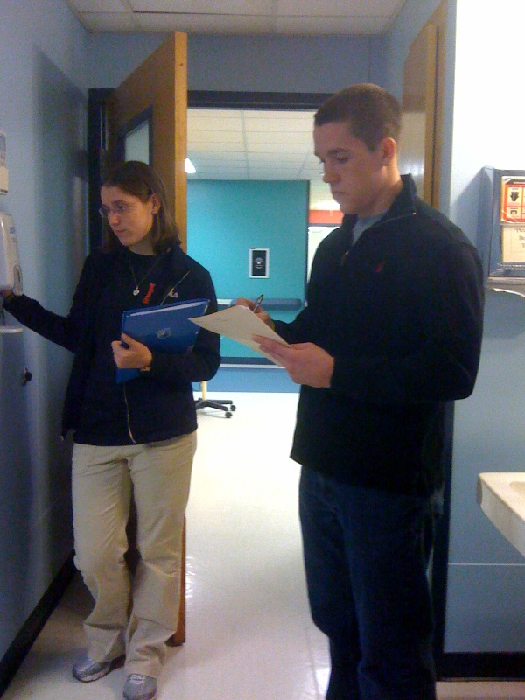
Methods Continued
Procedures:
Informed Consent (Parents) / Assent (Children)
Given first set of questionnaires
Interaction with therapy animal
Record observational data at this time
Given second set of questionnaires
Debriefed

Slide 9
Methods Continued
Measures:
Reynolds Child Depression Scale (William Reynolds)
‘I feel that no one cares about me’ (almost never – all the time)
Rosenberg Self-Esteem Inventory (Morris Rosenberg)
‘I like myself’ (strongly agree – strongly disagree)
State Anxiety Inventory for Children (Spielberger, et al.)
I feel… (very scared, scared, not scared)

Slide 10
Methods Continued
Measures:
Observational Data Sheet
Overall Quality of Interaction
Behavior of Child
Behavior of Animal
Other Observations

Slide 11
Statistical Analyses
Dependent t-test (Pre & Post)
Depression: Dependent t (17) = .93, p = .36
Anxiety: Dependent t (17) = .50, p = .62
Self-esteem: Dependent t (17) = .09, p = .93

Slide 12
Significant Results
*Determined through qualitative observation (1-5 Likert Scale)
Dependent t (17) = 3.7, p = .002

Slide 13
Qualitative Observations
Family members seemed to benefit just as much as the children did from the animal interaction.
Interaction with the dog handler also seemed to improve the mood of both the child and the family members present.

Slide 14
Discussion
There was a notable increase in the affect of the children following the interaction with the therapy animal.
Did not find the improvements in the emotional well-being as expected from the results of research on long-term effects
le Roux and Kemp (2009), Woolley (2005) and Cobaleda-Kegler (2006)
It can be argued that with children in particular, physical displays of emotion can be more telling than directly asking a child to reflect on his/her feelings.

Slide 15
Limitations
No control group
Knew what we were studying
Effects of novelty of visit wearing off
Dependent on WAGS & hospital
Small sample size

Slide 16
Future Directions/ Implications
Benefits of AAT on parents/family members
If short-term AAT was shown to be beneficial not only to the children, but to their family members as well, a stronger case could be made to utilize it as a means of improving the quality of the hospital stay for the all of those affected.

Slide 17
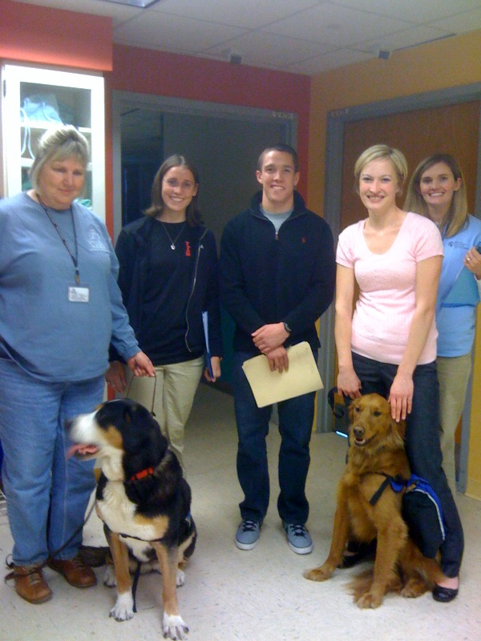
Special Thanks
Dr. Karen Frost (University of Louisville)
WAGS
Kosair Childrens Hospital

Slide 18
Questions? Comments?

