Slide 1

Human Cognition
What is cognition?
Notes:
1

Slide 2


Slide 3
Overview of Human-Computer Systems
Muscular Feedback
Cognitive Functions
Sensory Systems:
Human Input
Motor Functions:
Human Output
The Human-Computer Interface
Displays:
Machine Output
Controls:
Machine Input
Feedback within Machine
Mechanisms of Machine:
Performs Task and Determines State

Slide 4
A Human Information Processing Model after Wickens (1984)
Attentional
Resources
Short-Term
Sensory
Store
Decision
Making
Response
Execution
Perception
Working
Memory
(Immediate
Memory)
Long-Term
Memory
Memory
Feedback

Slide 5
Attention
What is it?
Why do we say that we have attention?

Slide 6
Attention and Visual Search

Slide 7
Spatial Cuing

Slide 8
Attention and Automaticity

Slide 9
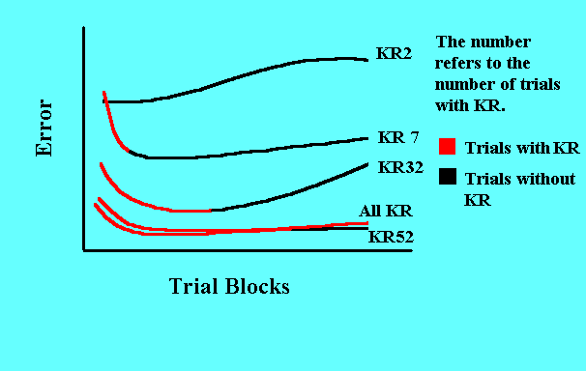
Knowledge of Results (Feedback) and Practice
With sufficient practice, KR can be removed without loss of performance (Newell, 1974).

Slide 10
Multitasking and attention
Is it possible to perform multiple tasks without one or more of them being detrimentally affected?
Ophir et al (2009) compared heavy vs light multi-taskers
  heavy were more prone to being distracted than those who infrequently multitask
  heavy multi-taskers are easily distracted and find it difficult to filter irrelevant information

Slide 11
So we sample sources of information

Slide 12
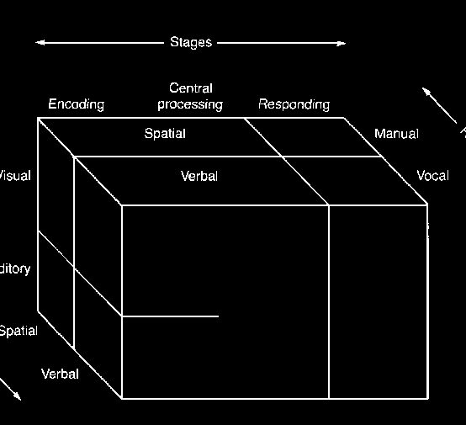
What makes sharing easier or harder (Wickens, 1984)

Slide 13
Design implications for attention
Make information salient when it needs attending to
Use techniques that make things stand out like color, ordering, spacing, underlining, sequencing and animation
Avoid cluttering the interface with too much information
Search engines and form fill-ins that have simple and clean interfaces are easier to use
Context
Notes:
13

Slide 14
The Process Model of Memory
Encoding
Storage
Retrieval
A memory failure may be due to a failure at any stage.

Slide 15
A Human Information Processing Model after Wickens (1984)
Attentional
Resources
Short-Term
Sensory
Store
Decision
Making
Response
Execution
Perception
Working
Memory
Long-Term
Memory
Memory
Feedback

Slide 16
Immediate Memory: Capacity

Slide 17
What some designers get up to…
Present only 7 options on a menu
Display only 7 icons on a tool bar
Have no more than 7 bullets in a list
Place only 7 items on a pull down menu
Place only 7 tabs on the top of a website page
      But this is wrong? Why?
Notes:
17

Slide 18
Immediate Memory: Duration and Function

Slide 19
Long-Term Memory: Encoding

Slide 20
Long-Term Memory: Storage & Retrieval

Slide 21
What do you remember the most?

Slide 22
Long-Term Memory: Context

Slide 23
Serial Position Effect

Slide 24
Release from Proactive Interference

Slide 25
Activity
Try to remember the dates of your grandparents’ birthday
Try to remember the cover of the last two DVDs you bought or rented
Which was easiest? Why?
People are very good at remembering visual cues about things
  e.g. the color of items, the location of objects and marks on an object
They find it more difficult to learn and remember arbitrary material
  e.g. birthdays and phone numbers
Notes:
25

Slide 26
Recognition versus recall
Command-based interfaces require users to recall from memory a name from a possible set of 100s
GUIs providMP3 players visually-based options that users need only browse through until they recognize one
Web browsers, etc., provide lists of visited URLs, song titles etc., that support recognition memory
Notes:
26

Slide 27
Memory aids
SenseCam developed by Microsoft Research Labs (now Autographer)
a wearable device that intermittently takes photos without any user intervention while worn
digital images taken are stored and revisited using special software
Has been found to improve people’s memory, suffering from Alzheimers

Slide 28
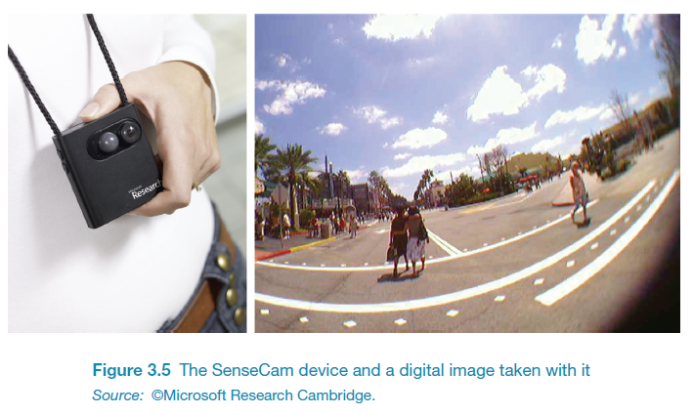
SenseCam

Slide 29
Language
The ease with which people can read, listen, or speak differs

Slide 30
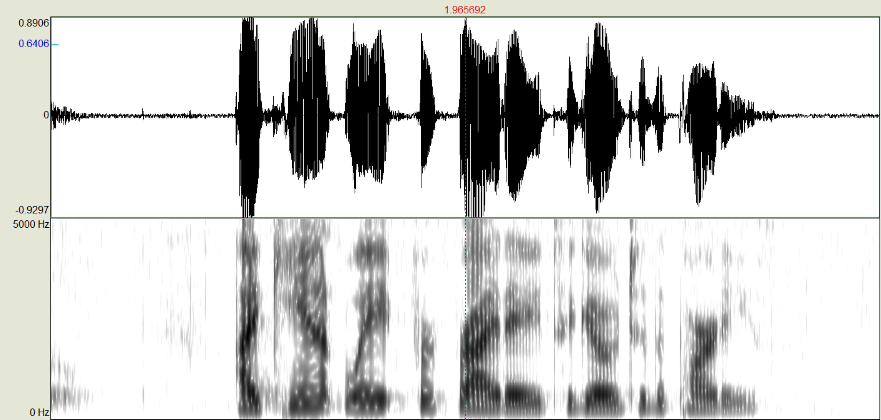
Speech: The sound spectrogram

Slide 31
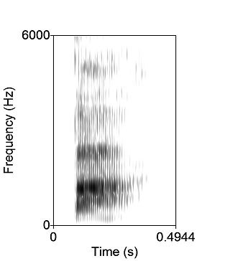
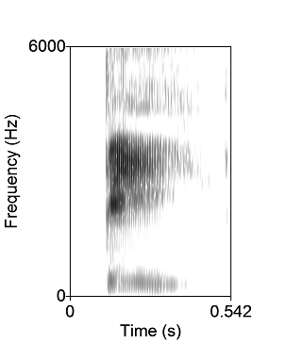
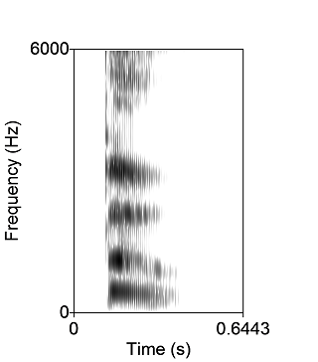

Ambiguity in the Speech Stimulus: Coarticulation
Ba
Bee
Boo

Slide 32

McGurk Effect

Slide 33
Context helps: Speech Blanking
Try this link

Slide 34
Problem-solving
All involves reflective cognition
  e.g. thinking about what to do, what the options are, and the consequences
Often involves conscious processes, discussion with others (or oneself), and the use of artefacts
  e.g. maps, books, pen and paper
May involve working through different scenarios and deciding which is best option

Slide 35
9 dot problem

Slide 37
Luchins Water Jar Problems
How would you use 3 jars with the indicated capacities to measure out the desired amount of water?
A
B
C
DESIRED
Problem 1
3
77
21
50
Problem 2
8
80
4
60
Problem 3
5
43
12
21
Problem 4
6
42
9
21
Problem 5
3
49
23
20
Problem 6
4
48
18
22

Slide 38
Luchins Water Jar Problems
How would you use 3 jars with the indicated capacities to measure out the desired amount of water?
A
B
C
DESIRED
solution
Problem 1
3
77
21
50
B-C-2A
Problem 2
8
80
4
60
B-C-2A
Problem 3
5
43
12
21
B-C-2A
Problem 4
6
42
9
21
B-C-2A
Problem 5
3
49
23
20
B-C-2A, but also C-A
Problem 6
4
48
18
22
B-C-2A, but also C-A
A simpler solution exists for problems 5 and 6, but subjects reached a
state of “Einstellung” where they kept applying old successful problem
solving methods.

Slide 39
Luchins Results
Group | Einstellung Solution (percent) | Direct Solution (percent) | No Solution (percent)
Control | 0 | 100 | 0
Experimental | 74 | 26 | 0
(Control subjects did not have the first four problems)

Slide 40
True Story
A professor comes to a University to give a talk. They up a slide projector for him, but neglect to test it. During the talk it becomes apparent that the projector is set too low. Graduate students and professors gather around the projector trying to fix the problem. They call out for a book to raise the front end of the projector. The book turns out to be too thick. They call out for a thinner book... While everyone is searching for another book, one person comes over and quietly solves the problem...
Punchline. All these academics in one room, and nobody knows how to open a book??
(from Ashcroft, 2002)

Slide 41
Another problem
A man climbs a mountain on Sat, leaving at daybreak and arriving at the top at sundown. He spends the night, gets up the next day at daybreak and heads down the mountain, following exactly the same path he climbed the day before.
Question: will there be any time during the second day when he will be at exactly the same point on the mountain he was at that time the first day?
B
A
SAT
SUN

