Slide 1
THE PROCESS OF INTERACTION DESIGN

Slide 2
What is involved in Interaction Design?

Slide 3
What is a user-centered approach?

Slide 4
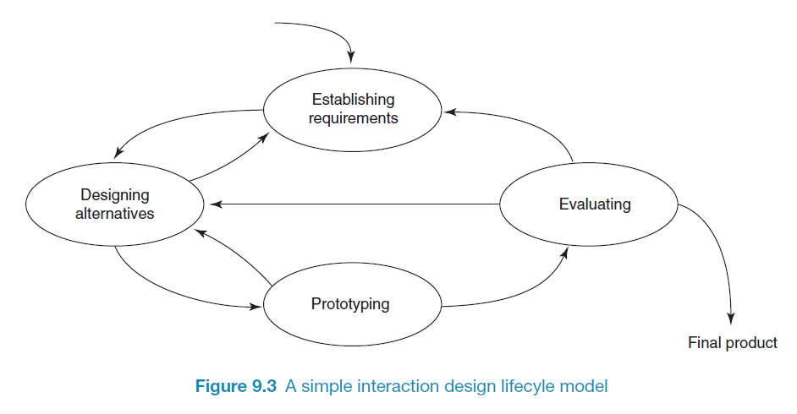
A simple interaction design lifecycle model
Exemplifies a user-centered design approach

Slide 5
Some practical issues
Who are the users?
What do we mean by ‘needs’?
How to generate alternatives
How to choose among alternatives

Slide 6
How to integrate interaction design in other models
Integrating interaction design activities in lifecycle models from other disciplines needs careful planning
Several software engineering lifecycle models have been considered
Integrating with agile software development is promising
it stresses the importance of iteration
it champions early and regular feedback
it handles emergent requirements
it aims to strike a balance between flexibility and structure

Slide 7
Summary
Four basic activities in the design process
Establishing requirements
Designing alternatives
Prototyping
Evaluating
User-centered design rests on three principles
Early focus on users and tasks
Empirical measurement using quantifiable & measurable usability criteria
Iterative design

